Slide 1

IoT with AWS
Aws hands on

Slide 2
What is aws
Amazon Web Services
First largest pioneer in cloud services market
Cloud Computing Solutions

Slide 3
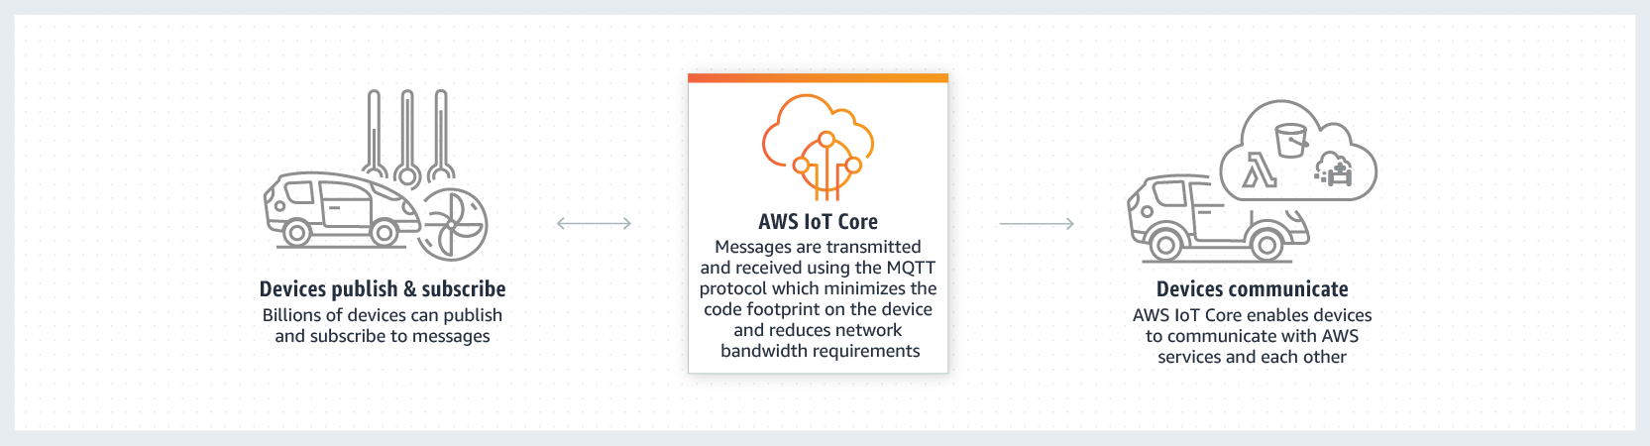
Internet of Things with AWS
AWS IoT Core work?
Connect and manage your devices

Slide 4
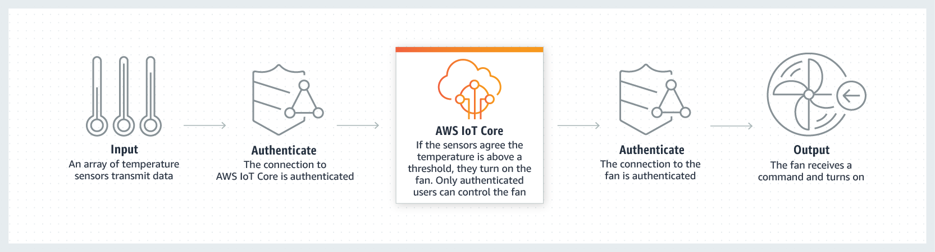
Internet of Things with AWS
Secure device connections and data

Slide 5
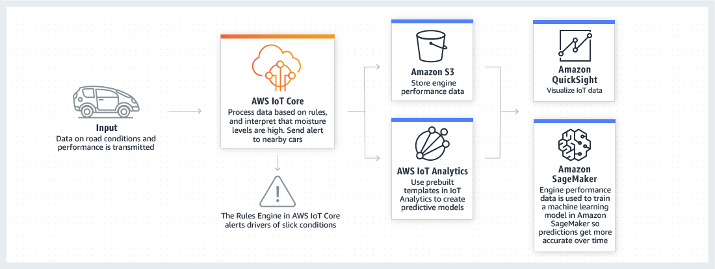
Internet of Things with AWS
Process and Act on Data

Slide 6
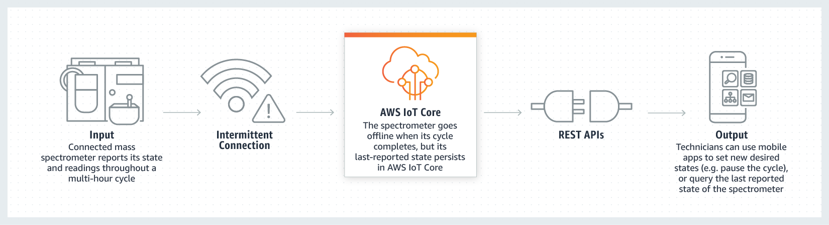
Internet of Things with AWS
Read and set device state at any time

Slide 7
Get Started with AWS
Signup for aws account
Sign up for free 1 year trial
Enter credit card information
Log in

Slide 8
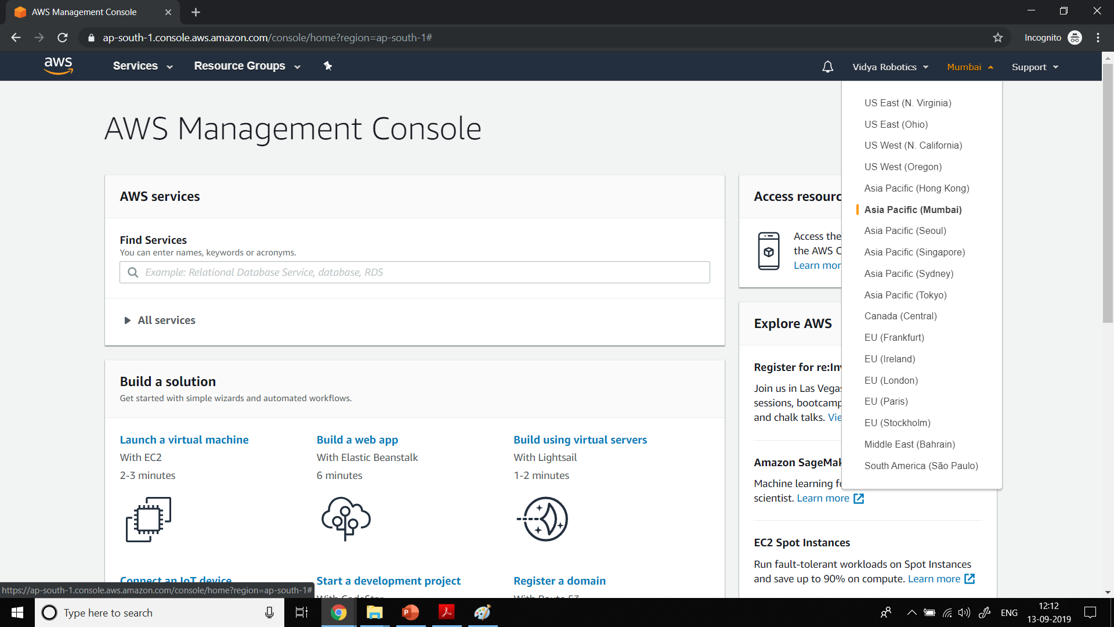

Slide 9
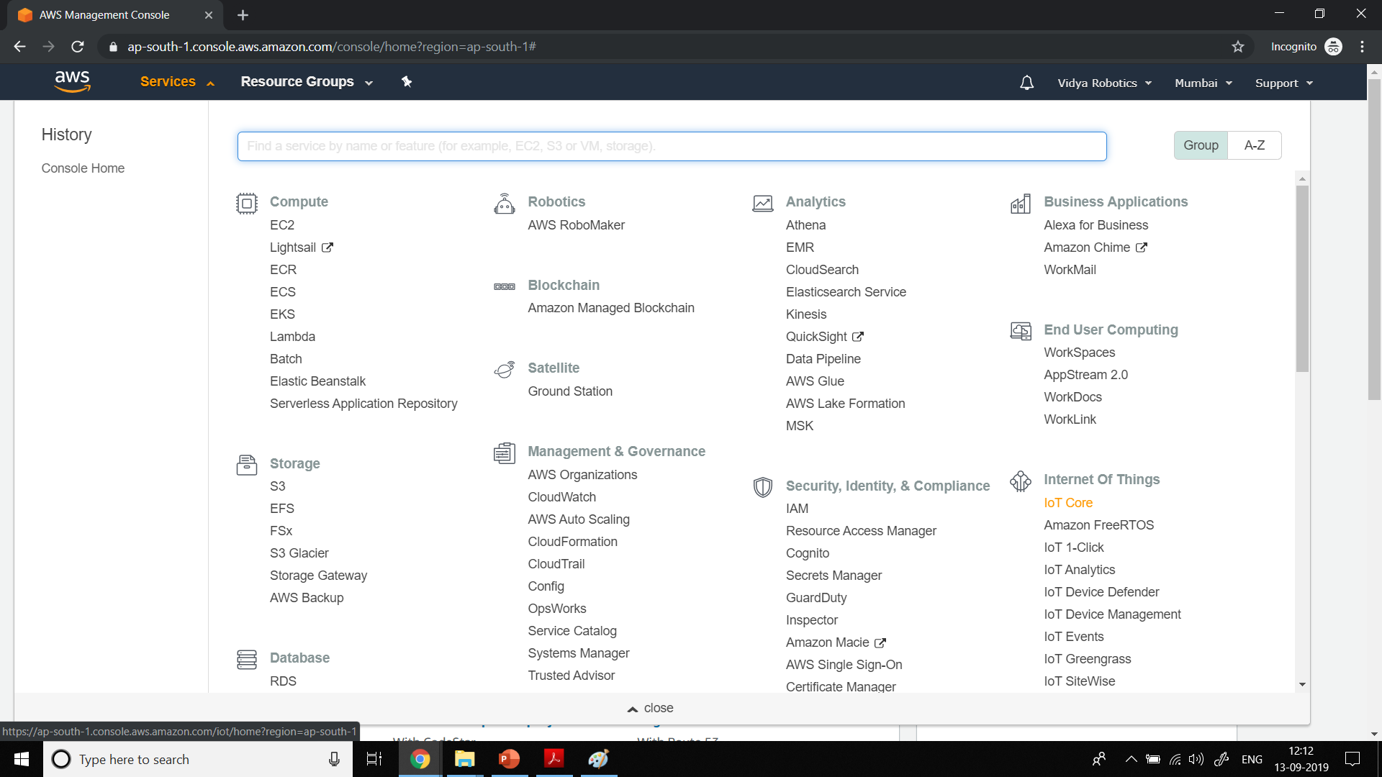

Slide 10
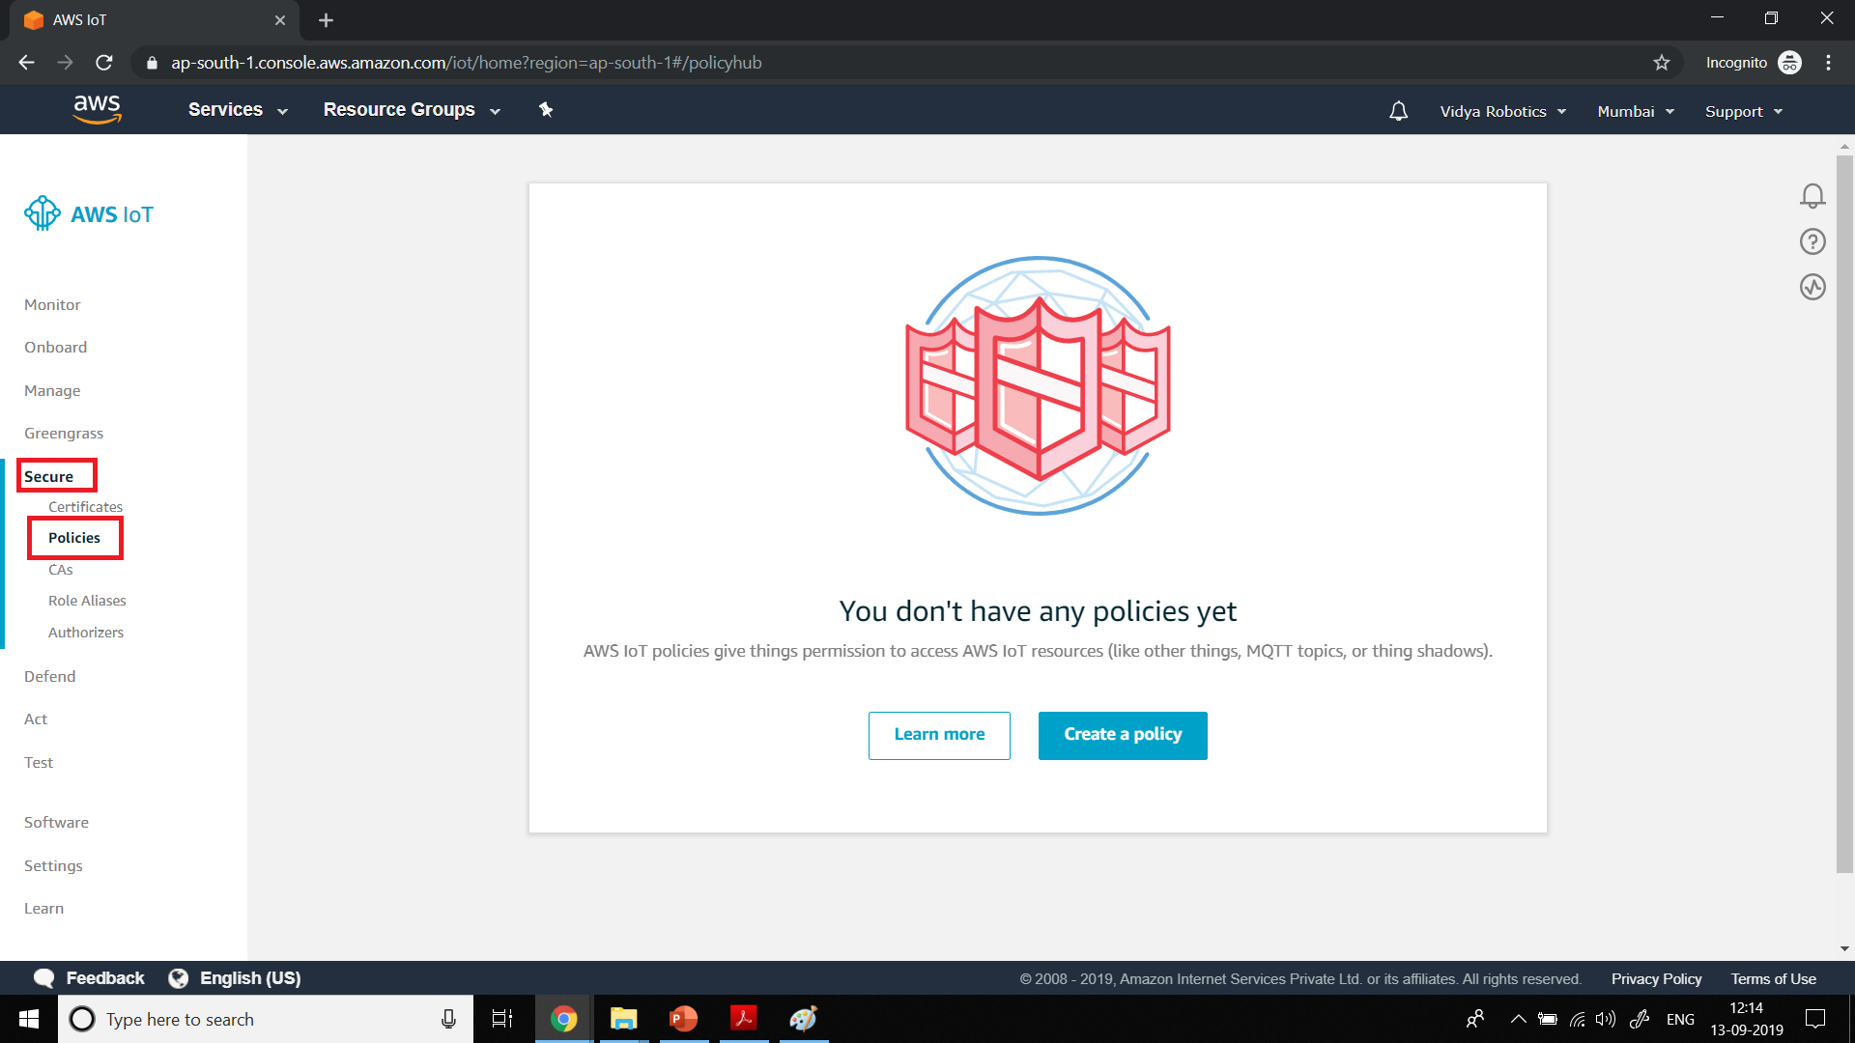

Slide 11
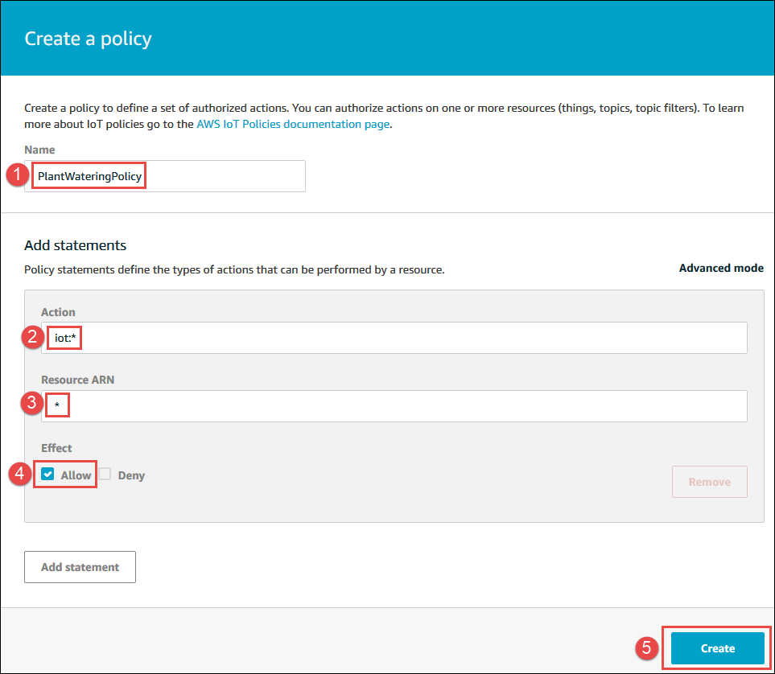

Slide 12
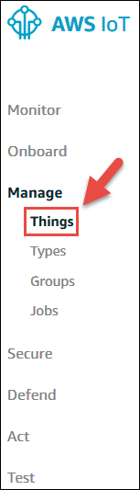

Slide 13
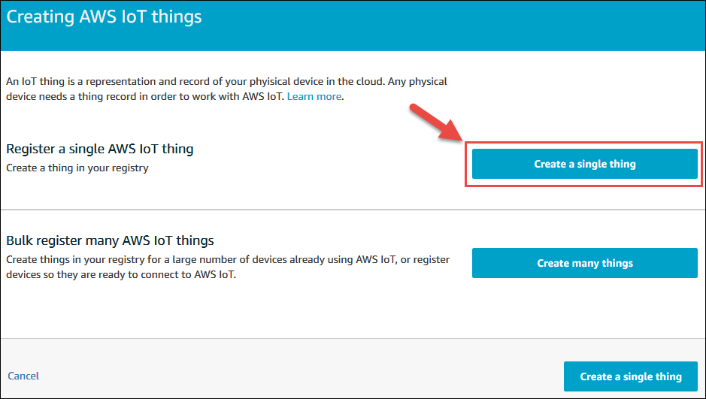

Slide 14
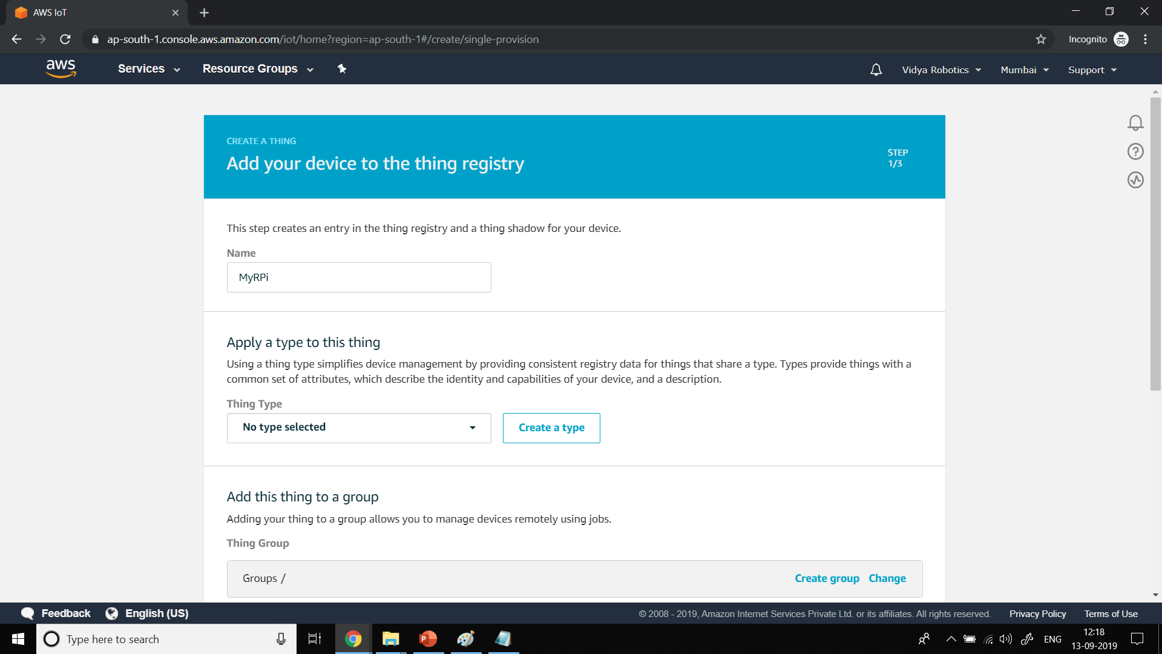

Slide 15
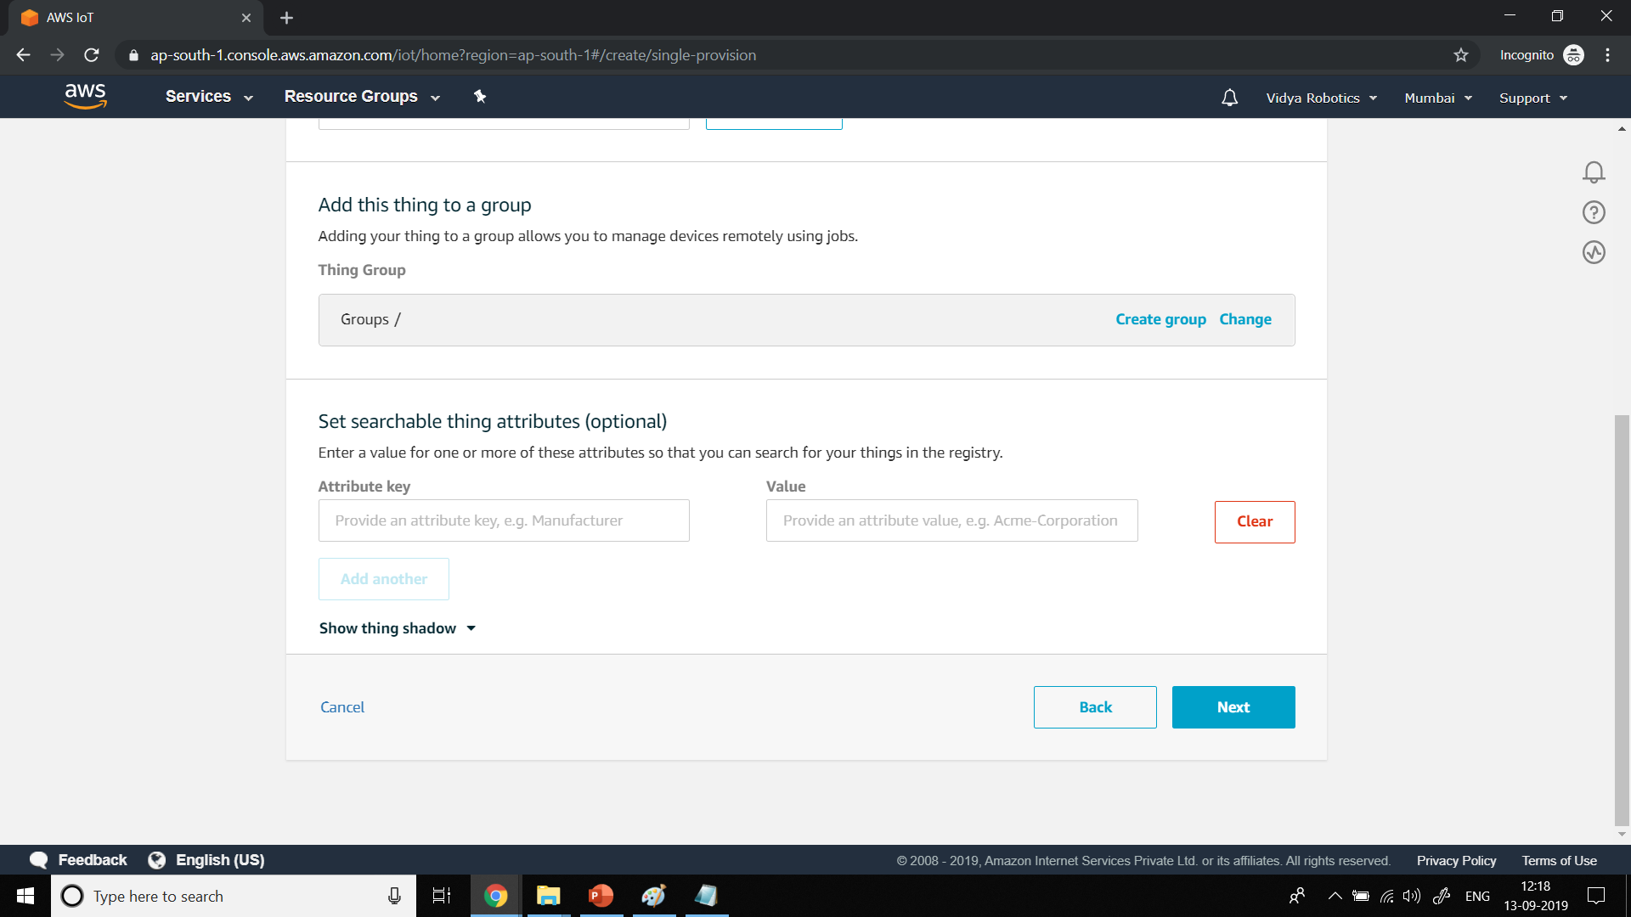

Slide 16
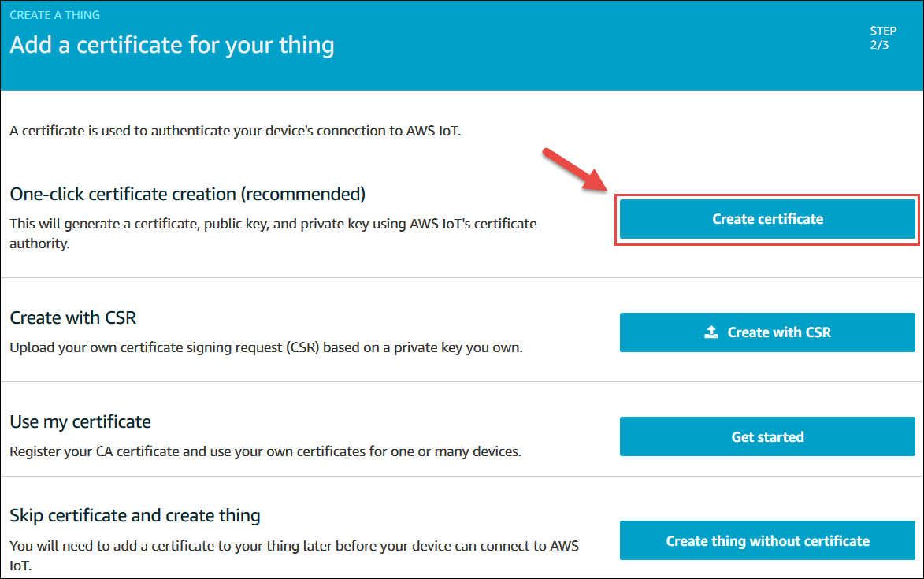

Slide 17
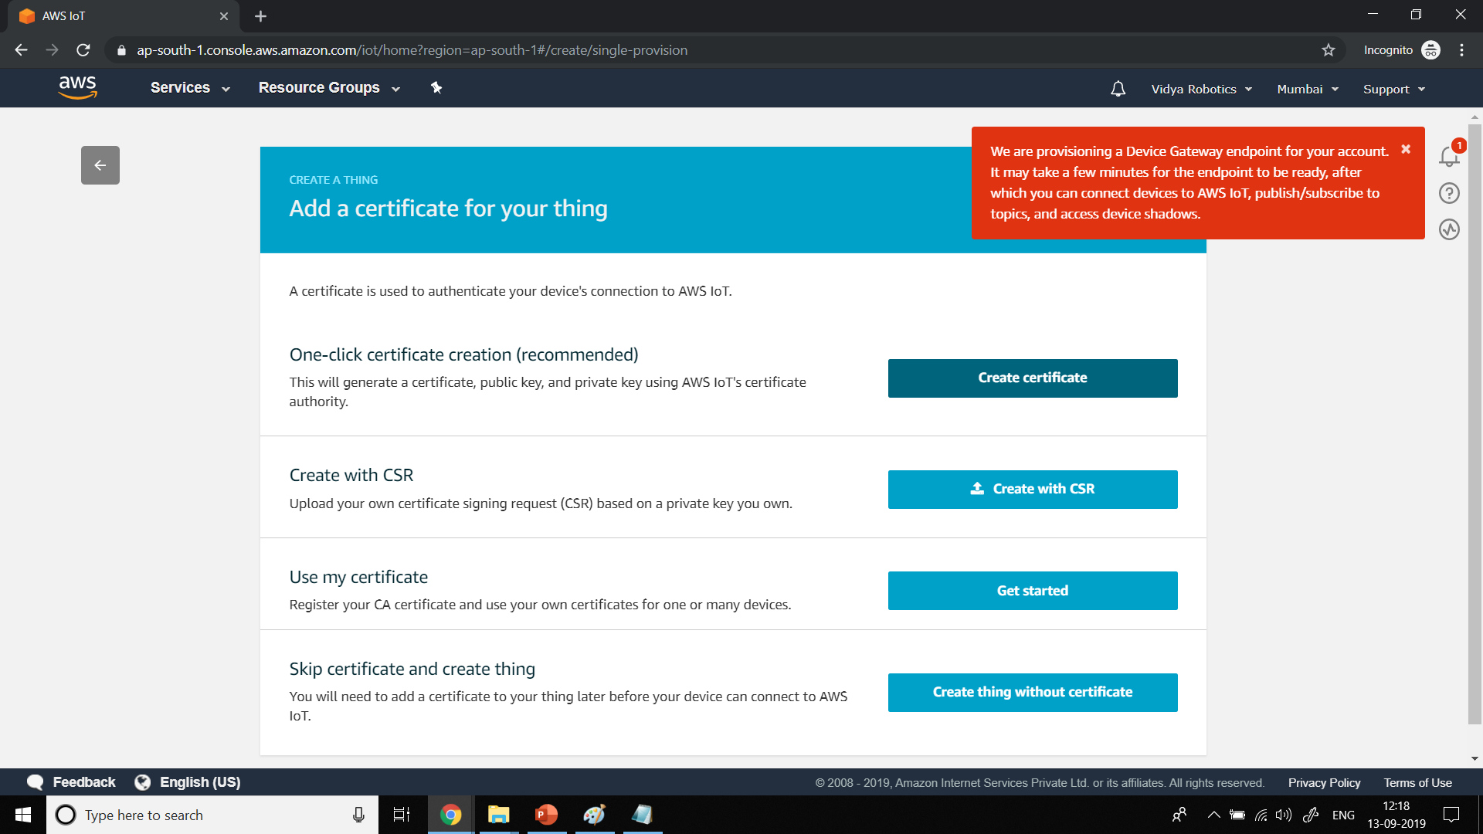

Slide 18
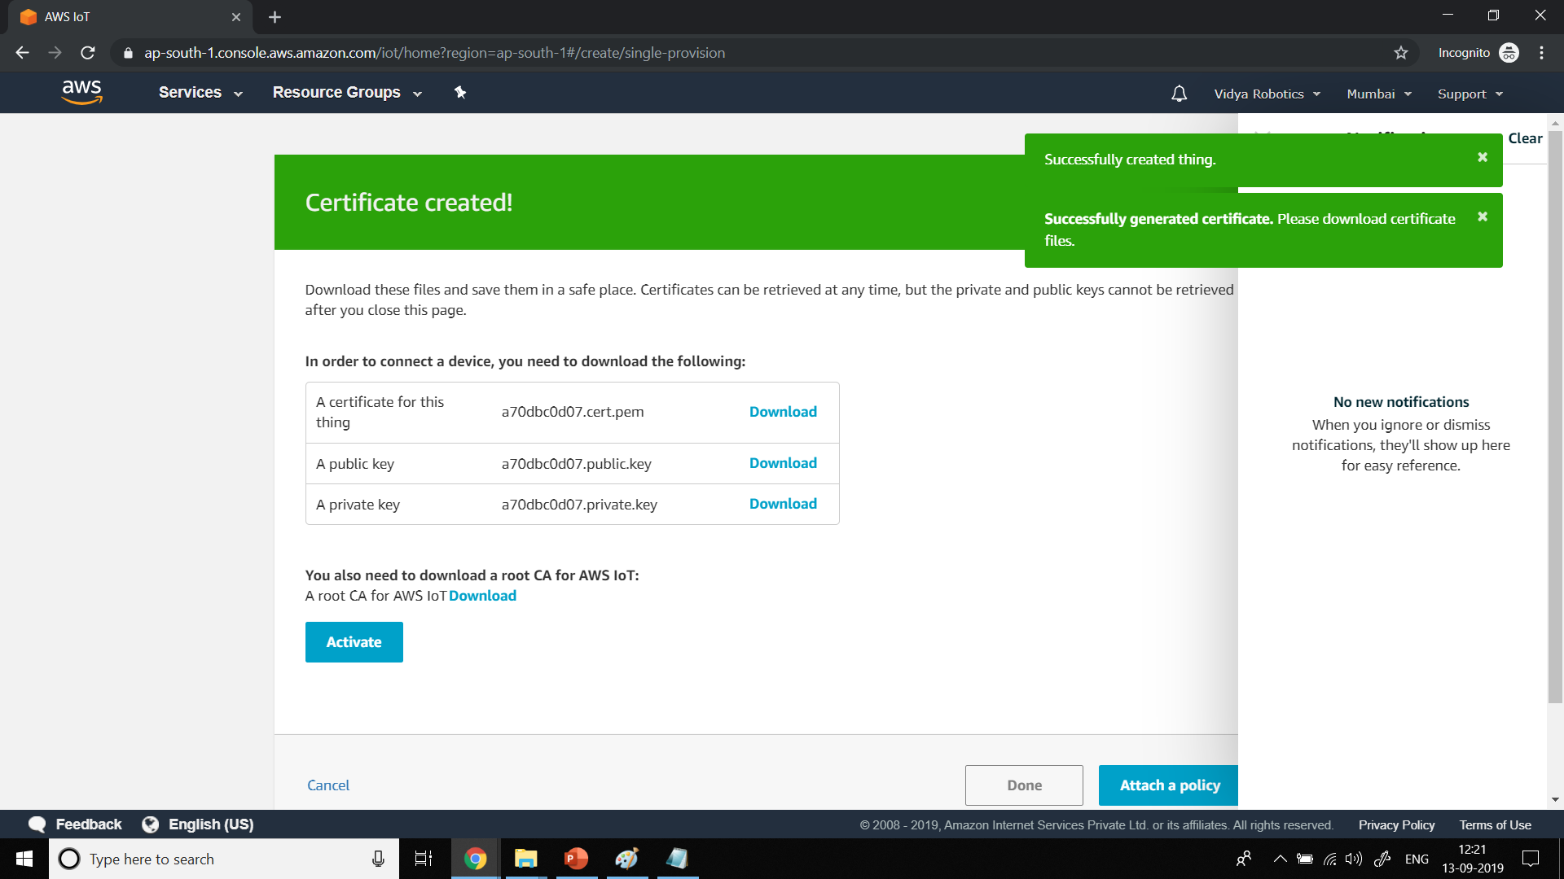

Slide 19
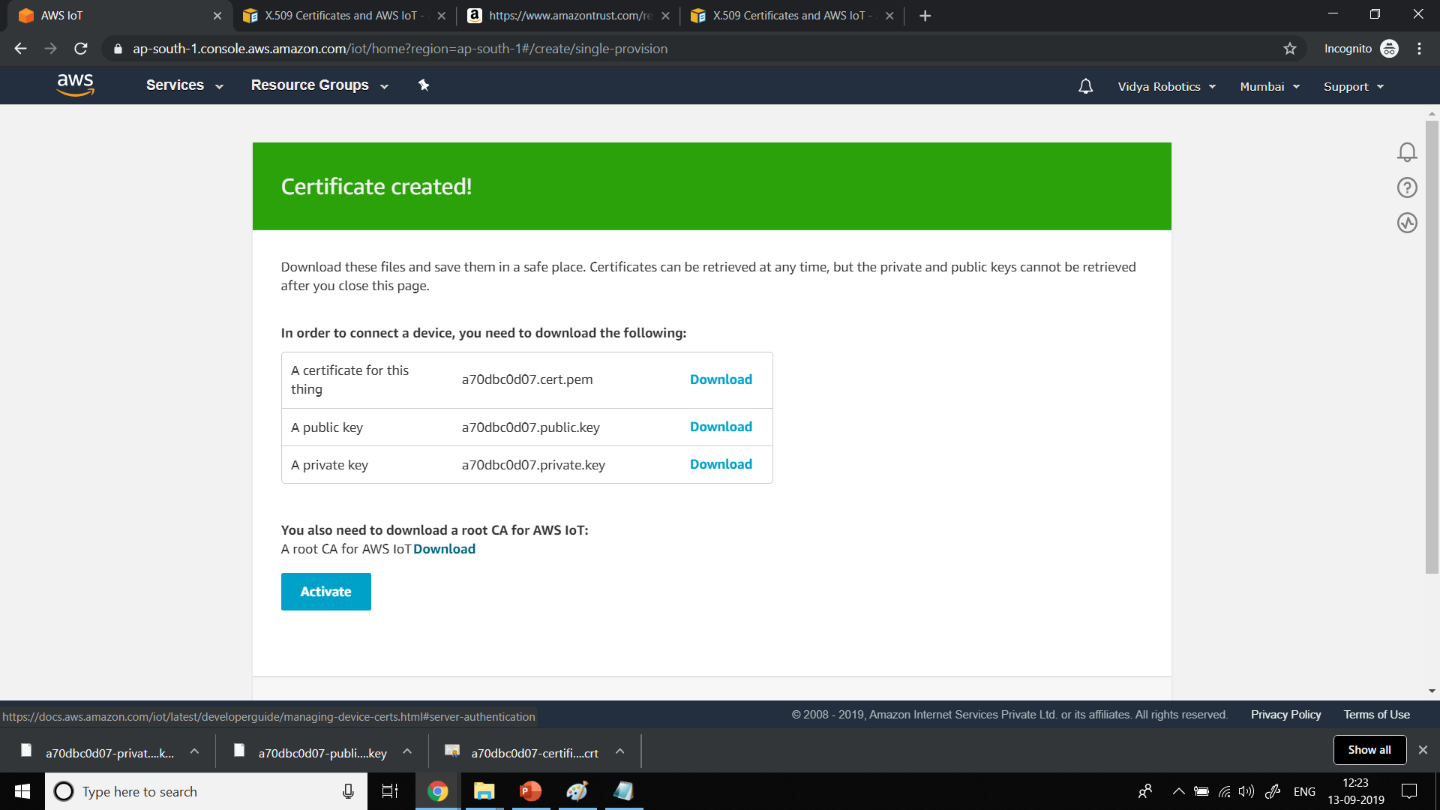

Slide 20
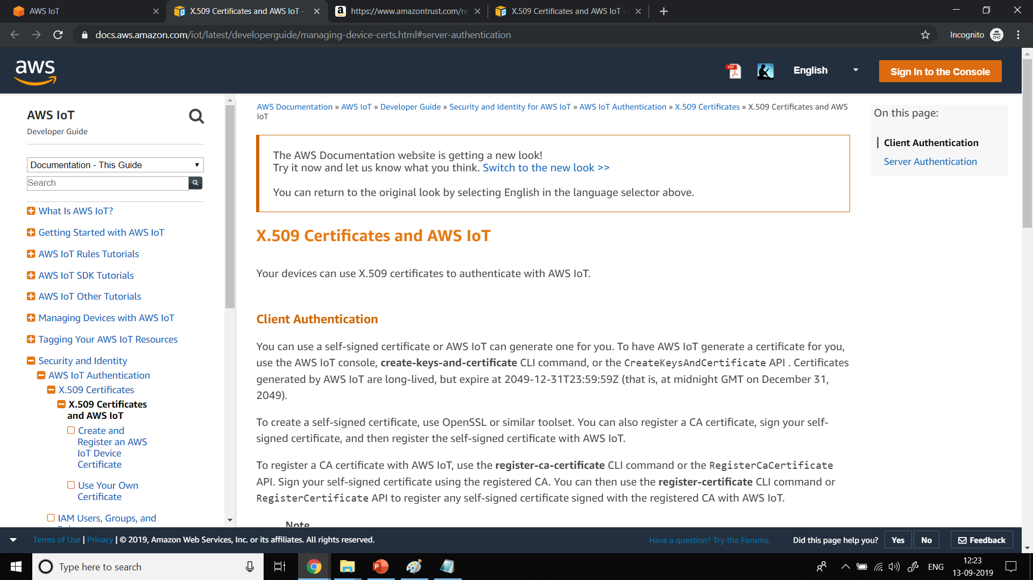

Slide 21
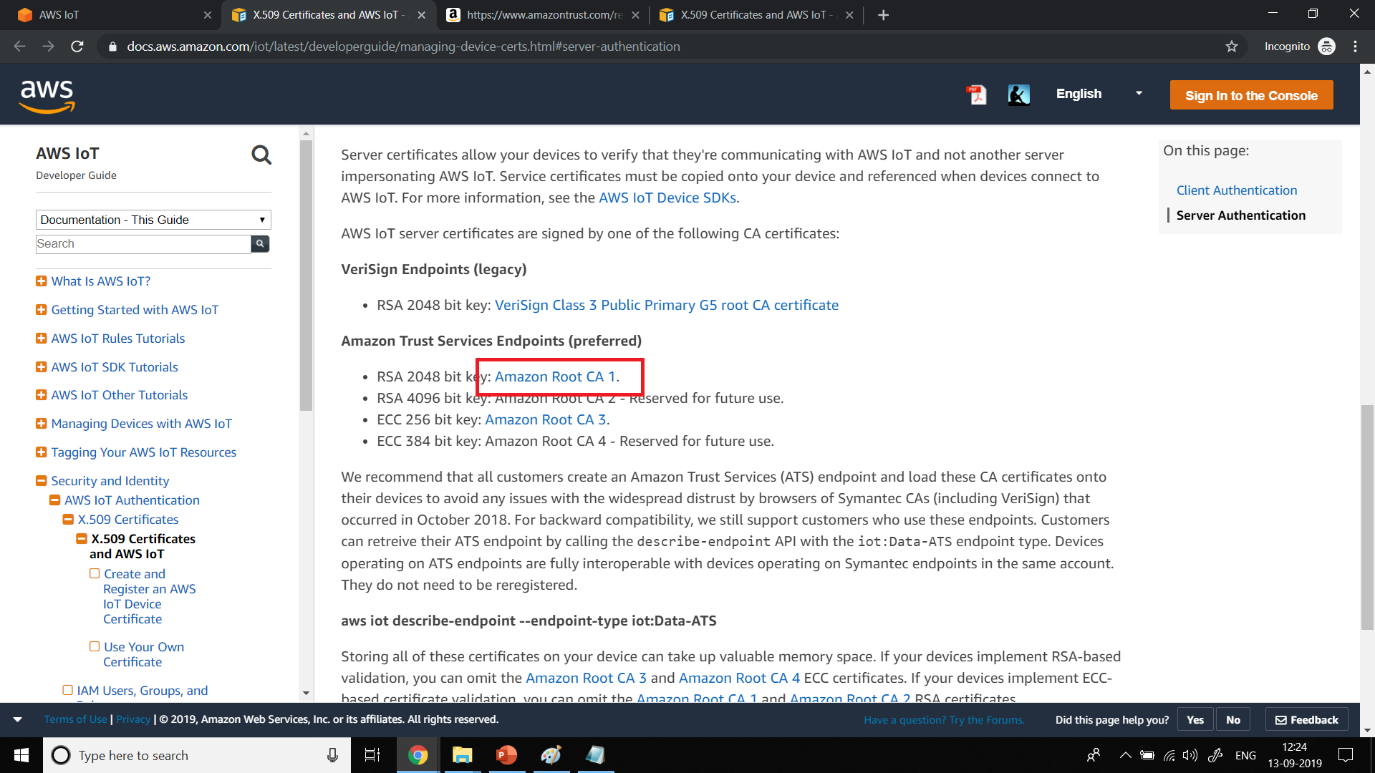

Slide 22
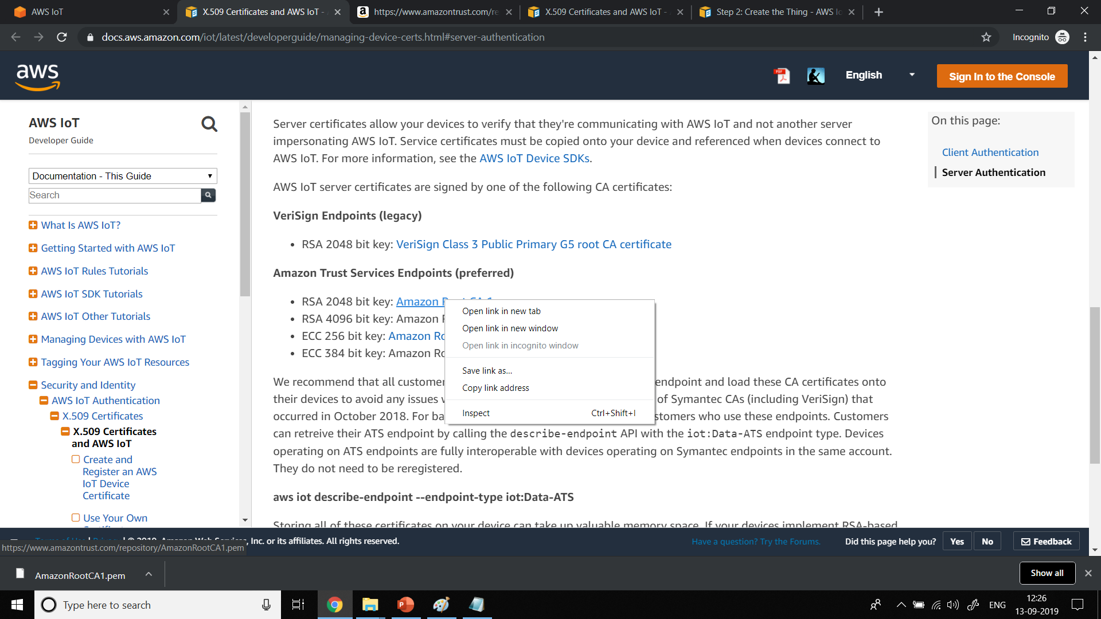

Slide 23
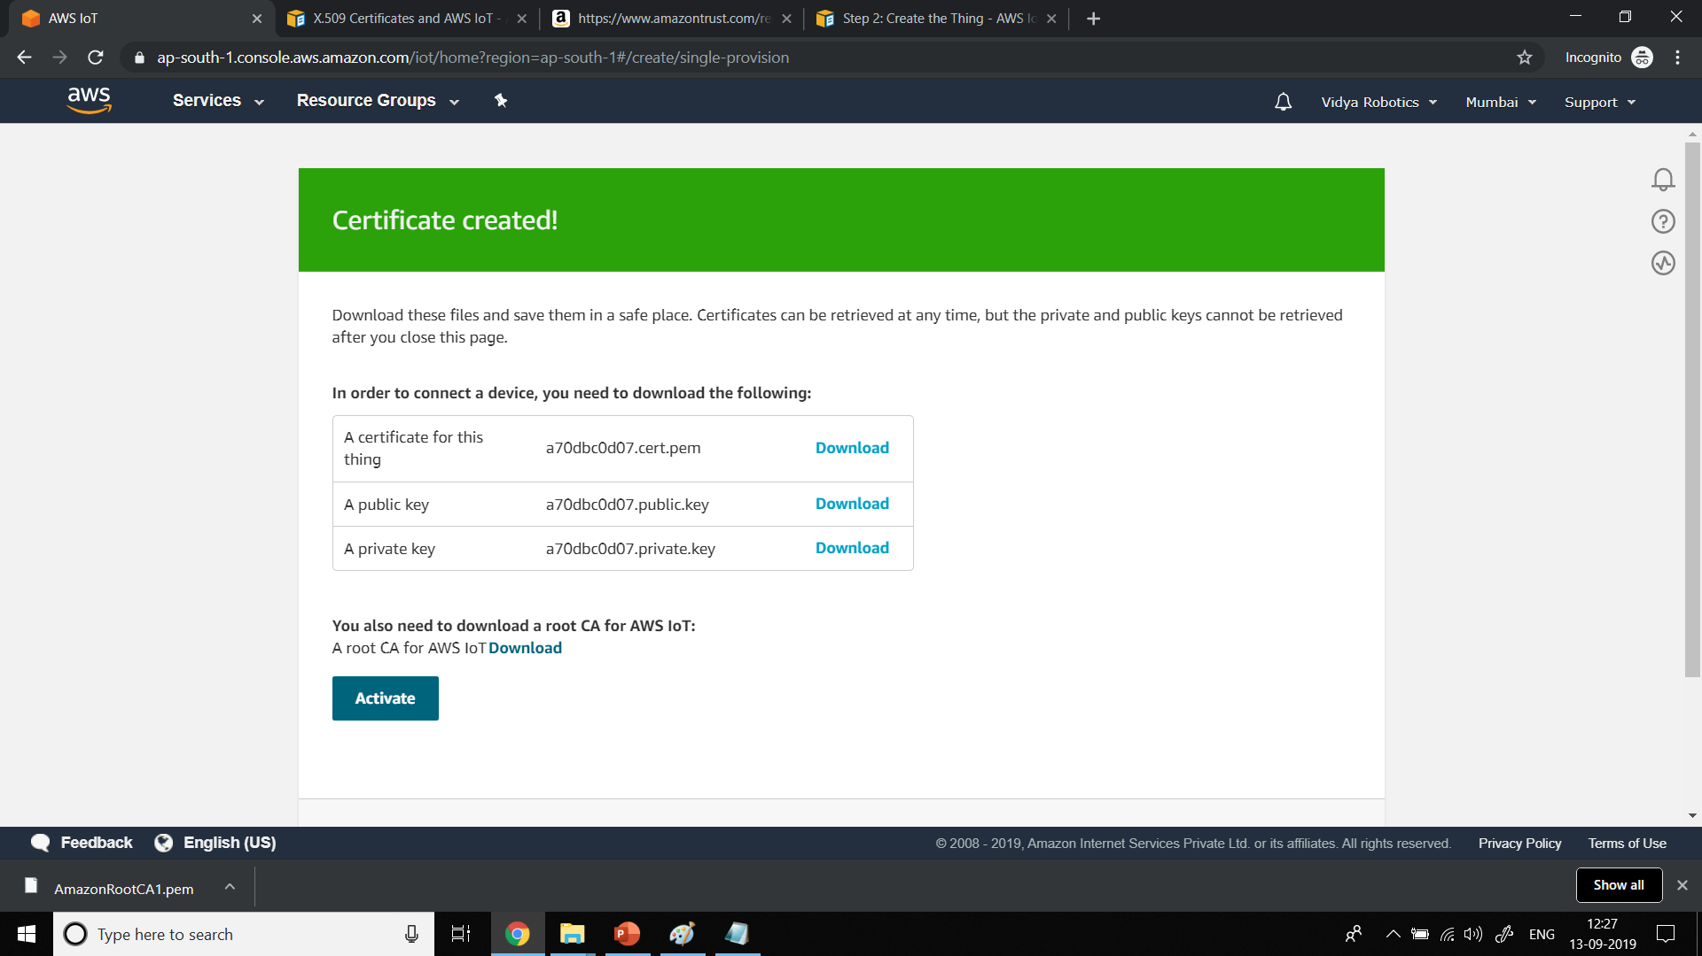

Slide 24
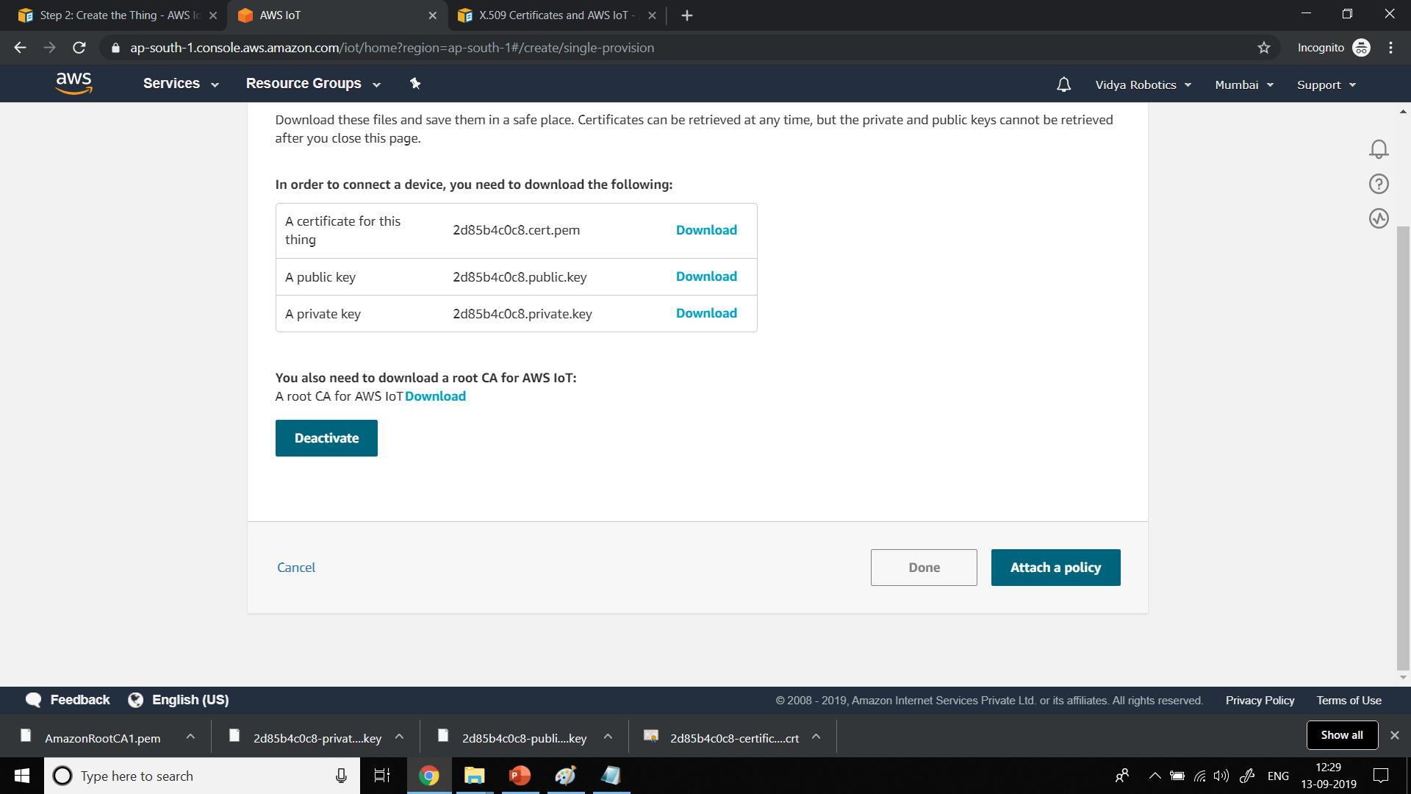

Slide 25
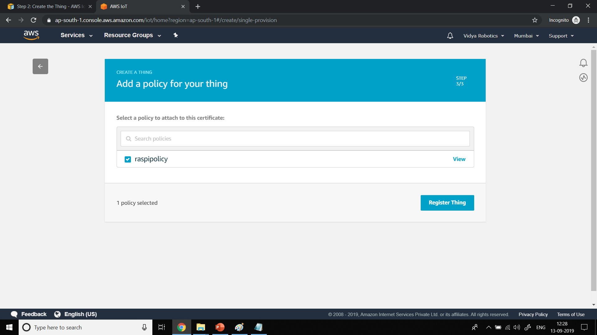

Slide 26
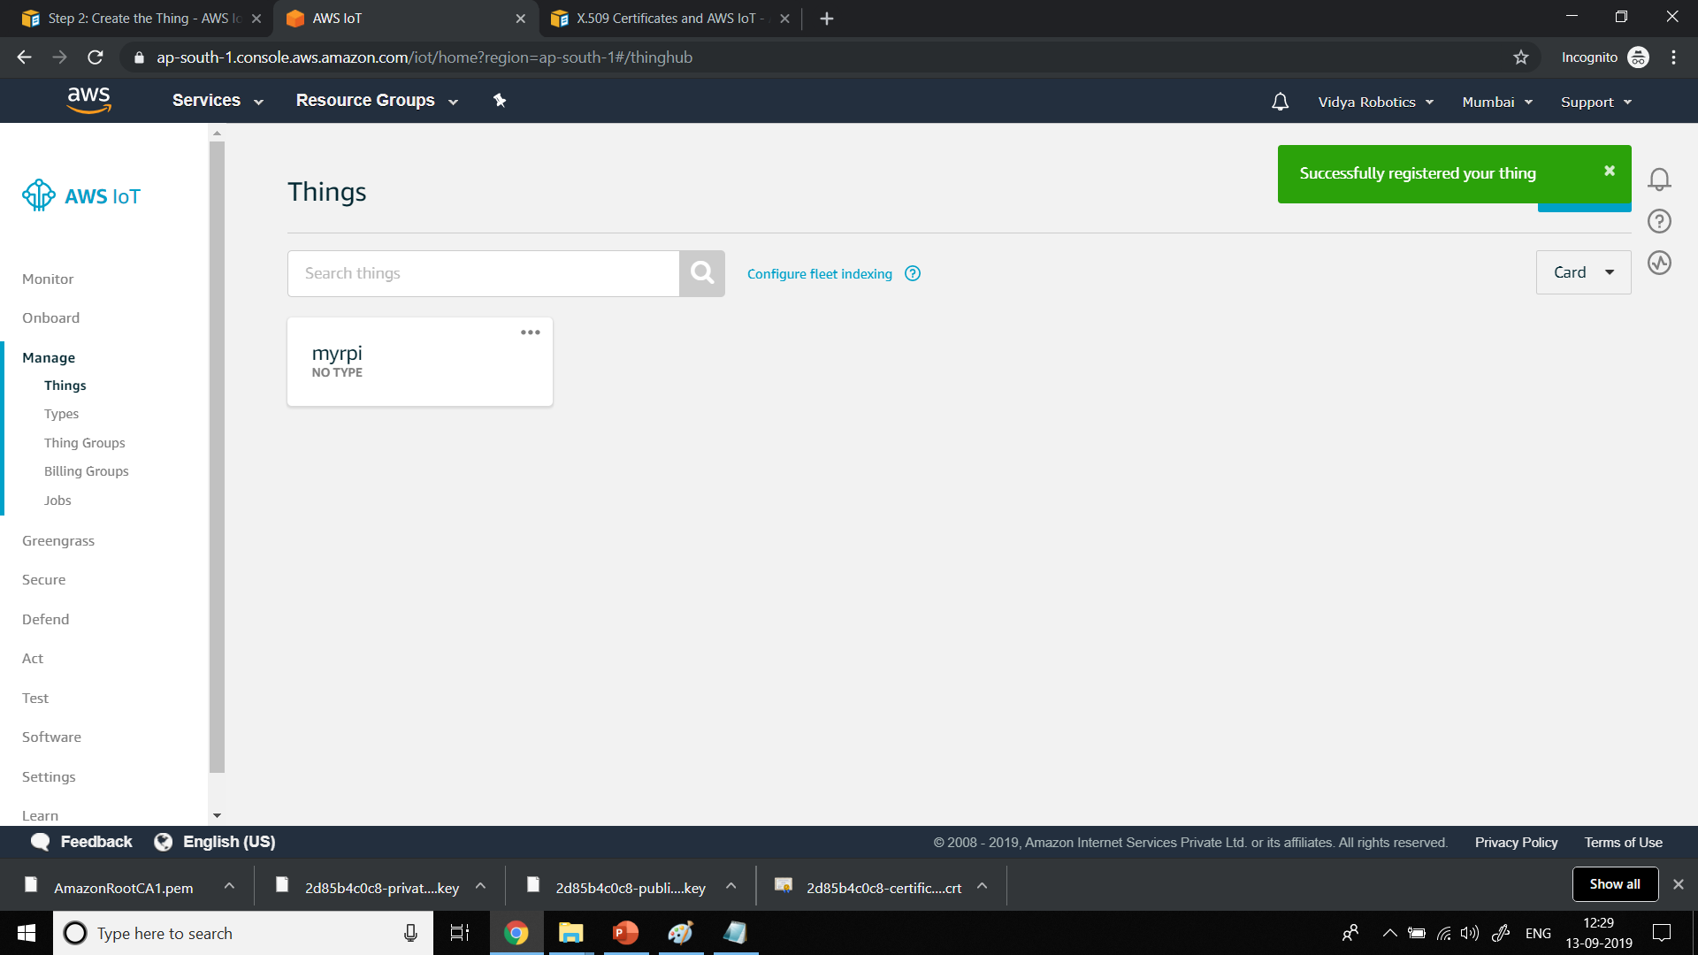

Slide 27
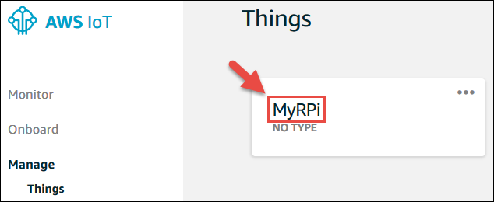

Slide 28
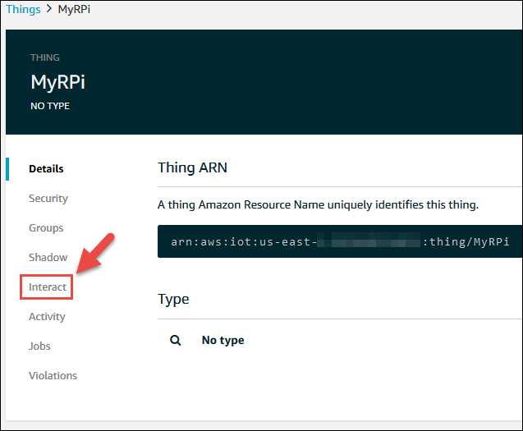

Slide 29
Update to this thing shadow (for example, $aws/things/MyRPi/shadow/update )
Get this thing shadow (for example, $aws/things/MyRPi/shadow/get )
Accepted to get this thing shadow (for example, $aws/things/MyRPi/shadow/get/accepted )

Slide 30
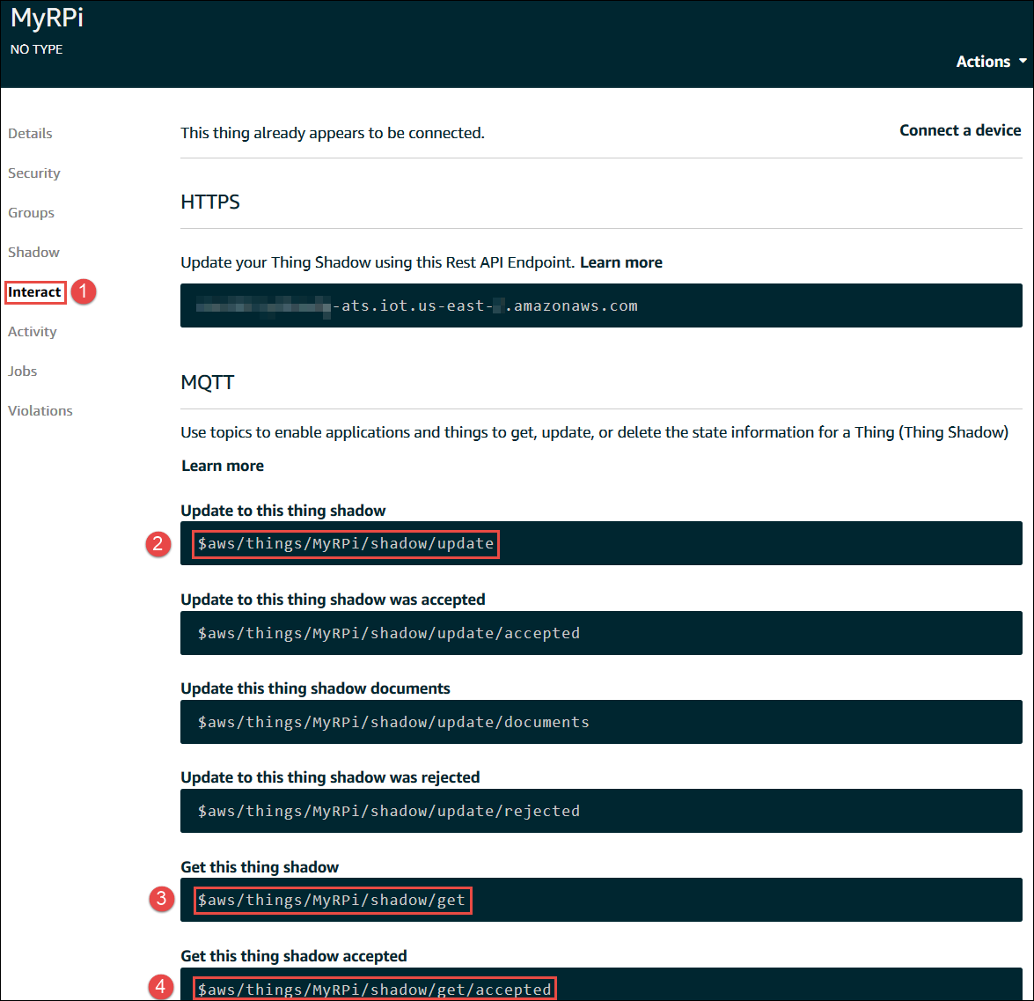

Slide 32
Select the "Back" button.
If the AWS IoT Device Management Introduction dialog is displayed, select Show Later or press Esc .
In the service navigation pane, select Test .

Slide 33
For the subscription topic , enter the MQTT topic value
(for example, $aws/things/MyRPi/shadow/update )
that you updated to this thing shadow record in previous procedure, and then select the subscription topic .

Slide 34
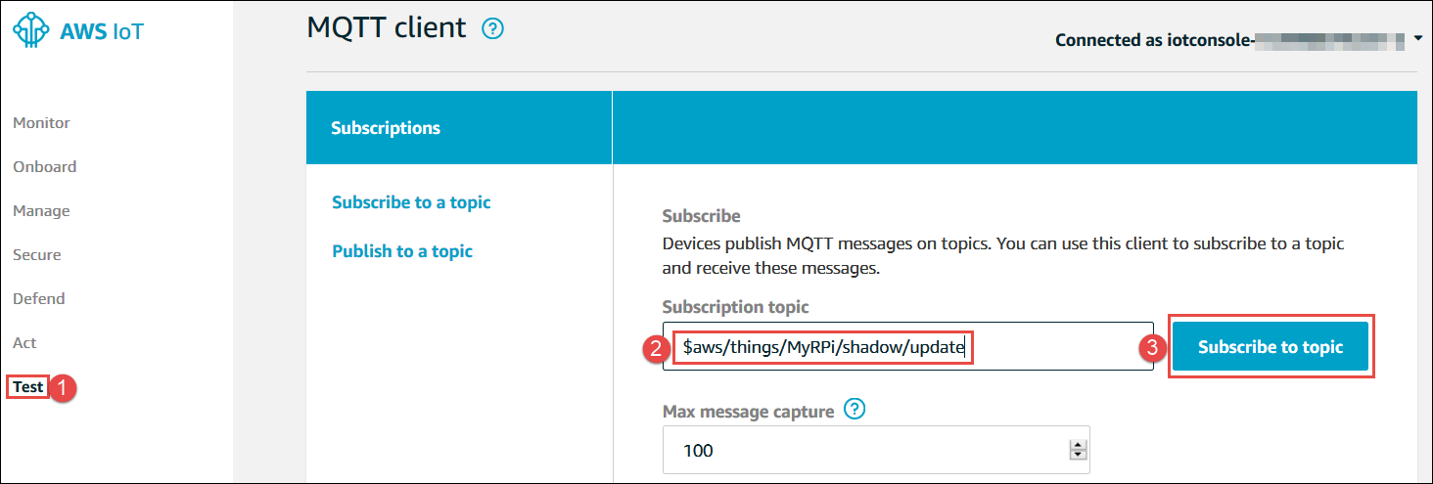

Slide 36
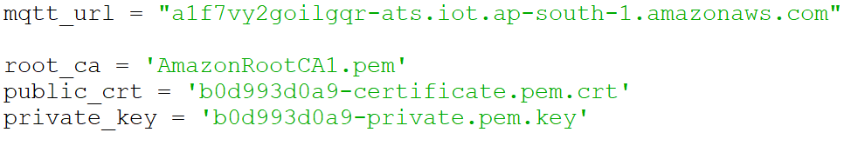
Install Library and Test Code
sudo pip3 install AWSIoTPythonSDK
aws_mqtt_test.py
Change the MQTT URL with the ARN we’ve saved
Change the names of certificate files

Slide 37
AWS MQTT TEST Code
aws_mqtt_test.py

Slide 38
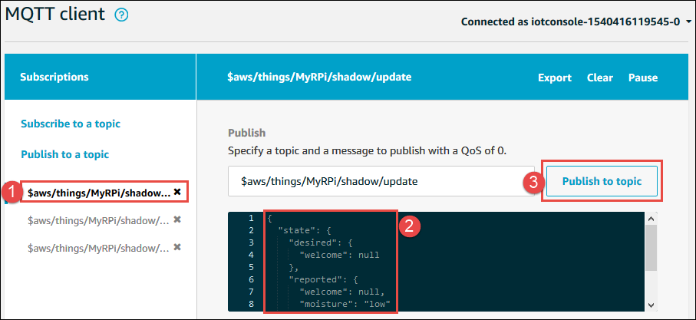

Slide 39
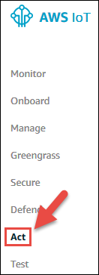
Email alerts

Slide 40
Email alert steps
you see that you don't have any rules dialogs, select Create a rule . Otherwise, choose Create .
On the Create Rule page, enter a name for this rule (for example, MyRPiLowMoistureAlertRule ). If you use a different name, be sure to replace it with this name in this example.
For the description , please provide a meaningful description for this rule, for example, Sends an alert whenever soil moisture level readings are too low .
For rule query statements , use the SQL version set to 2016-03-23 . In the Rule Query Statement box, enter the following AWS IoT SQL statement in a single line, without any line breaks:

Slide 41
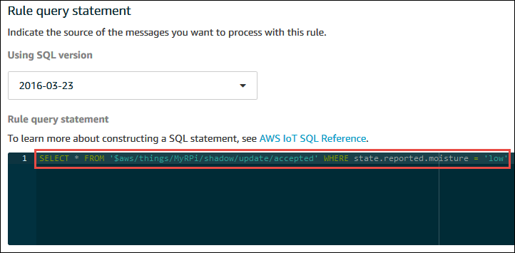
Rule Query
SELECT * FROM '$aws/things/MyRPi/shadow/update/accepted' WHERE state.reported.moisture = 'low'

Slide 42
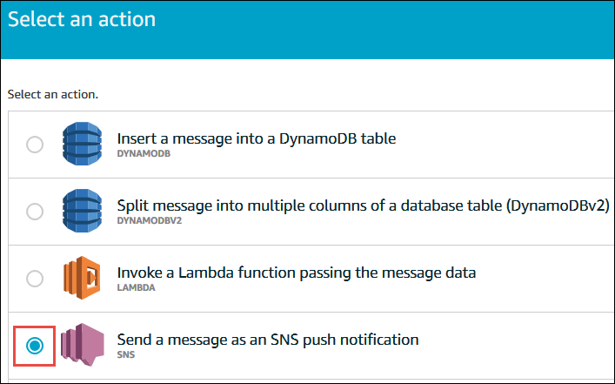
Select an action

Slide 43
Next Steps
selectlect Configure action .
On the Configure Actions page, select Create for the SNS target . Enter the name of the SNS topic, such as MyRPiLowMoistureTopic , and select Create . If you choose to use a different name, be sure to replace it with this name in this example.
For Message format , choose RAW .
For the IAM role name , select Create a new role and enter a name for the new role, such as MyRPiLowMoistureTopicRole . If you choose to use a different name, be sure to replace it with this name in this example.
Choose Create a new role .
For the IAM role name , select MyRPiLowMoistureTopicRole .
Select Add Action .

Slide 44
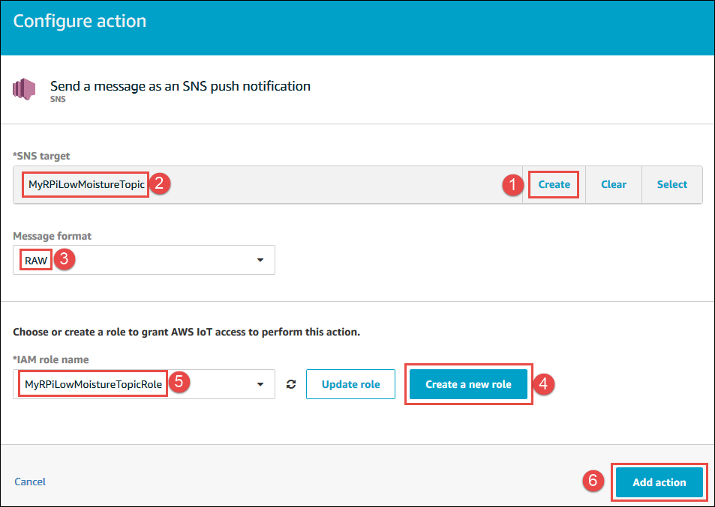

Slide 45
Subscription
Choose Create rule .
Set up Amazon SNS to send messages to your email inbox via an Amazon SNS topic. In the AWS navigation bar, select a service . In the Find service by name or feature box, type SNS and press Enter .
In the service navigation pane, choose Subscribe .

Slide 46
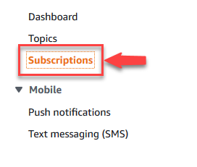

Slide 47
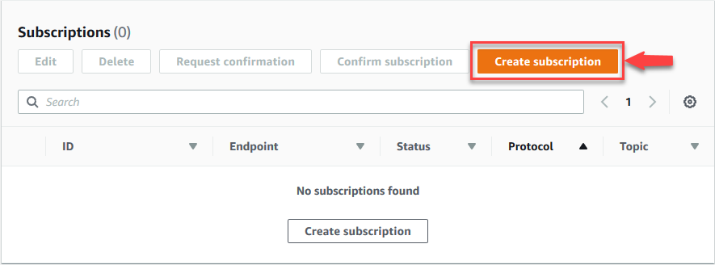

Slide 48
For the topic ARN , select the ARN for the topic that was created when the action was previously configured during this process.
For the agreement , select Email .
For Endpoint , enter your email address.
Choose Create subscription .
Check the subscription confirmation email in your inbox titled AWS Notification – Subscription Confirmation from no-reply@sns.amazonaws.com (AWS Notifications – Subscription Confirmation from no-reply@sns.amazonaws.com) . Once you receive the email, open the email and click the Confirm subscription link. When you click the link, a confirmation page will appear in your web browser. You can close this confirmation page.

Slide 49
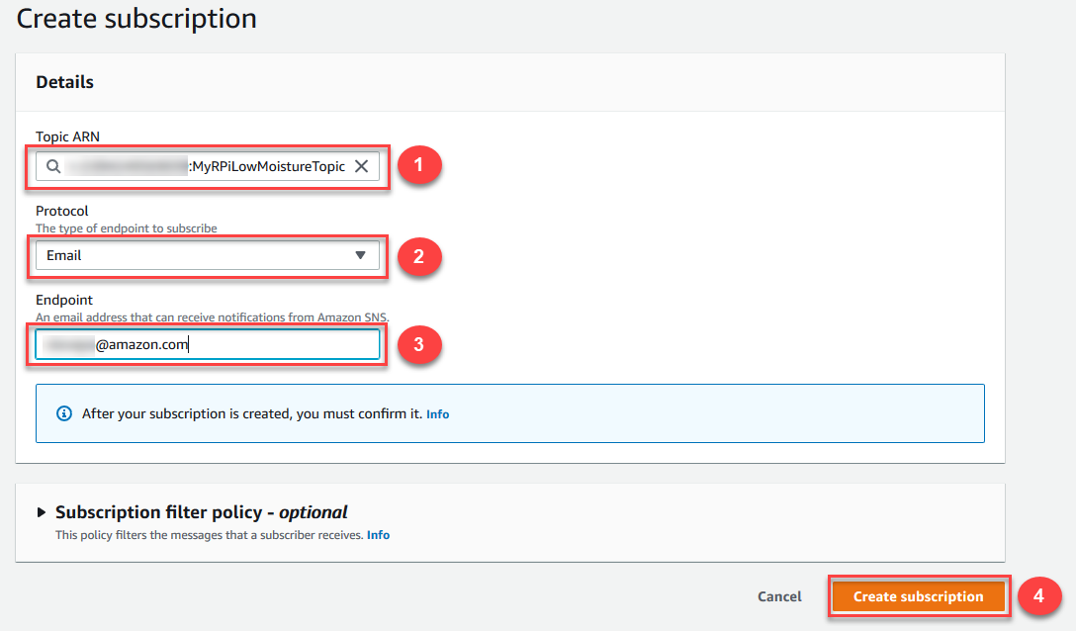

Slide 51
Test Code

Slide 52
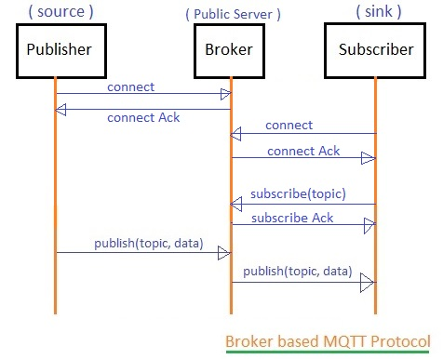
MQTT

Slide 53
Test mqtt with sample Topics

Slide 54
MQTT Code
pip install paho-mqtt
pip3 install paho-mqtt

Slide 55
AWS Data Storage
Using DynamoDB
DynamoDB rules allow you to take information from an incoming MQTT message and write it to a DynamoDB table.

Slide 56
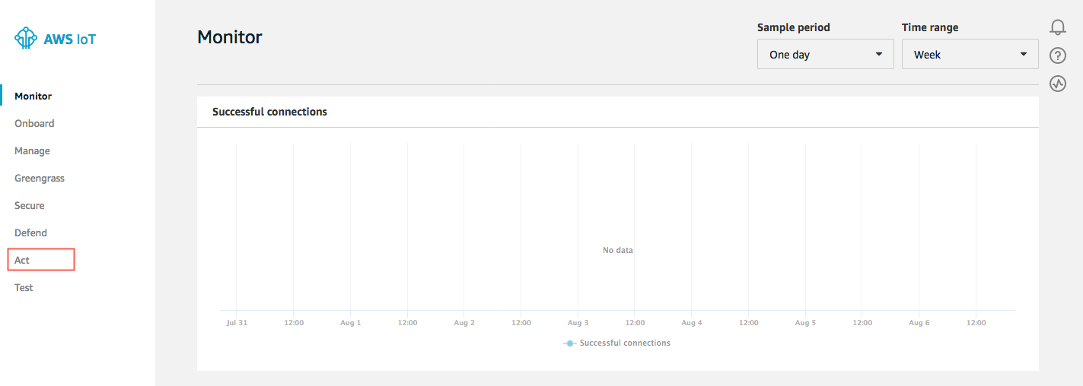

Slide 57
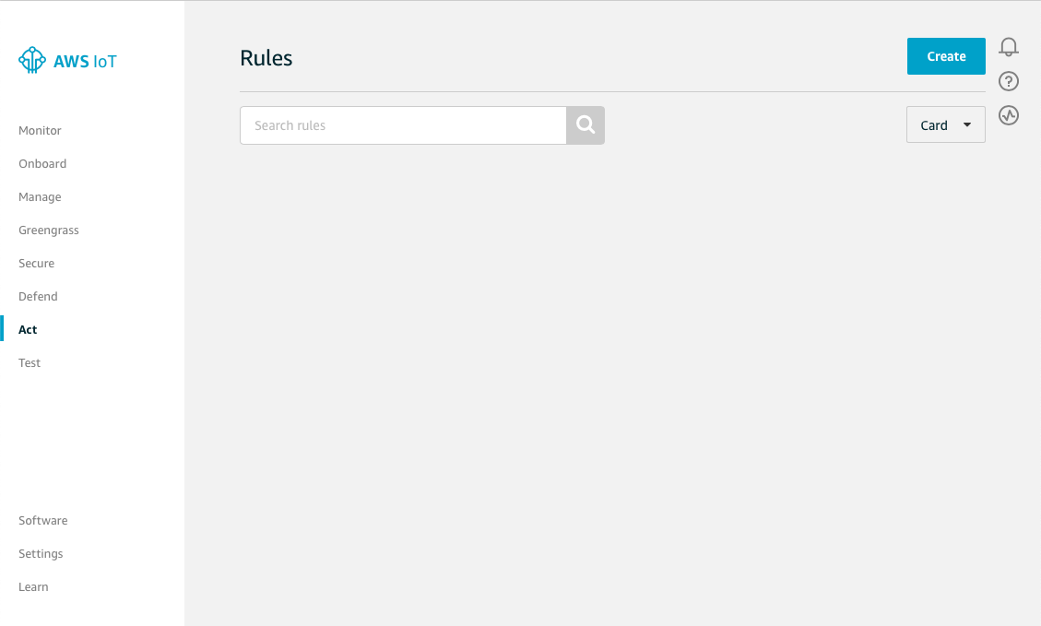

Slide 58
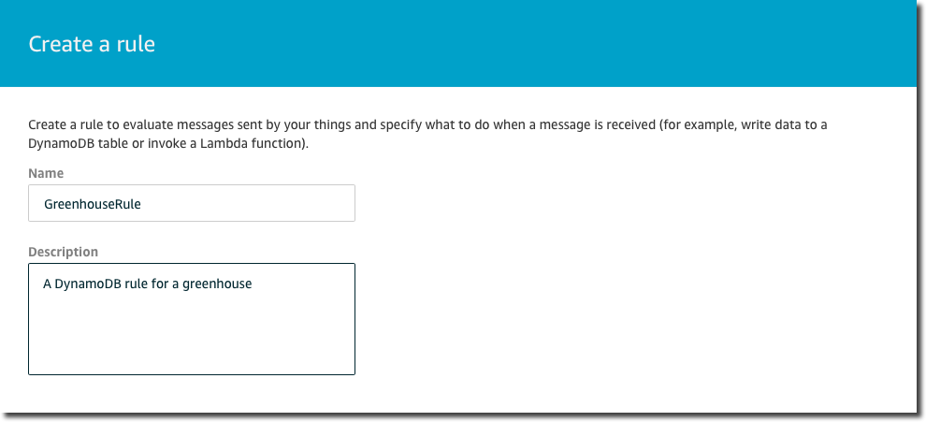

Slide 59
dynamoDB
Under Rule query statement, choose the latest version from the Using SQL version list. For Rule query statement, enter:
SELECT * FROM 'my/greenhouse'

Slide 60
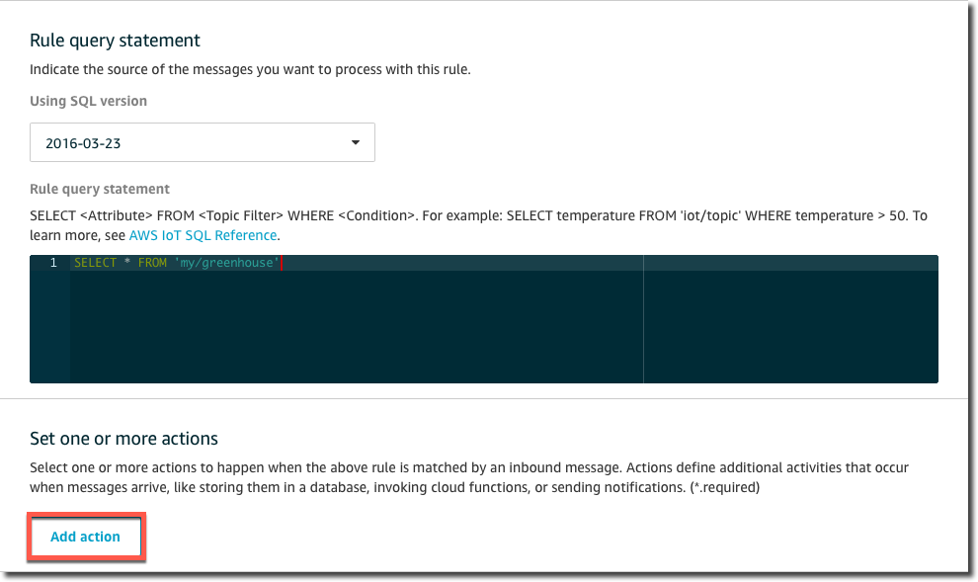

Slide 61
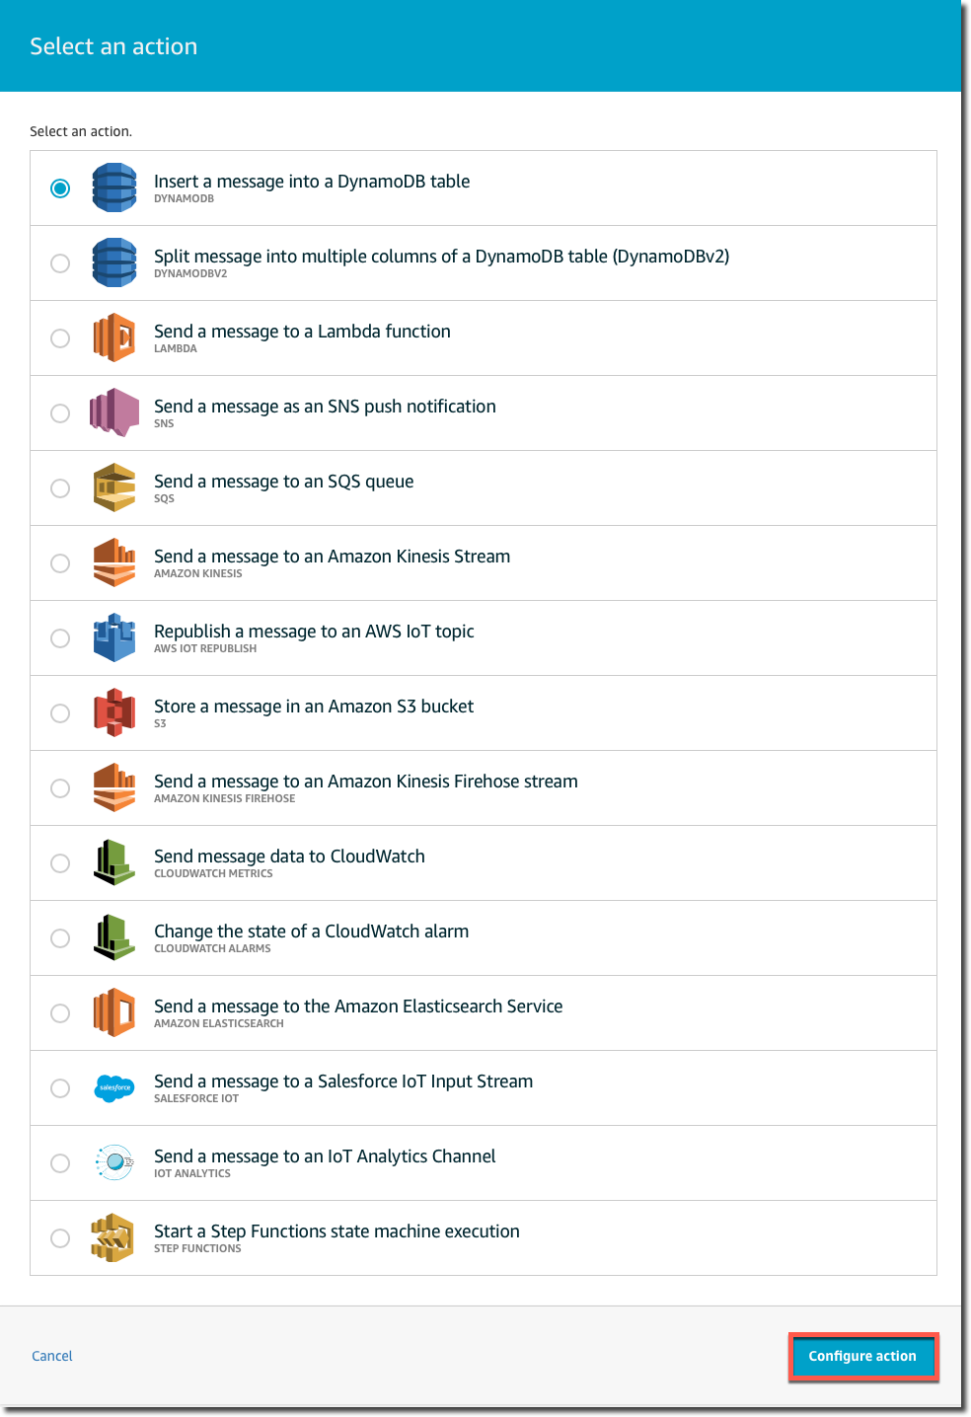

Slide 62
dynamoDB
On the Configure action page, choose Create a new resource.

Slide 63
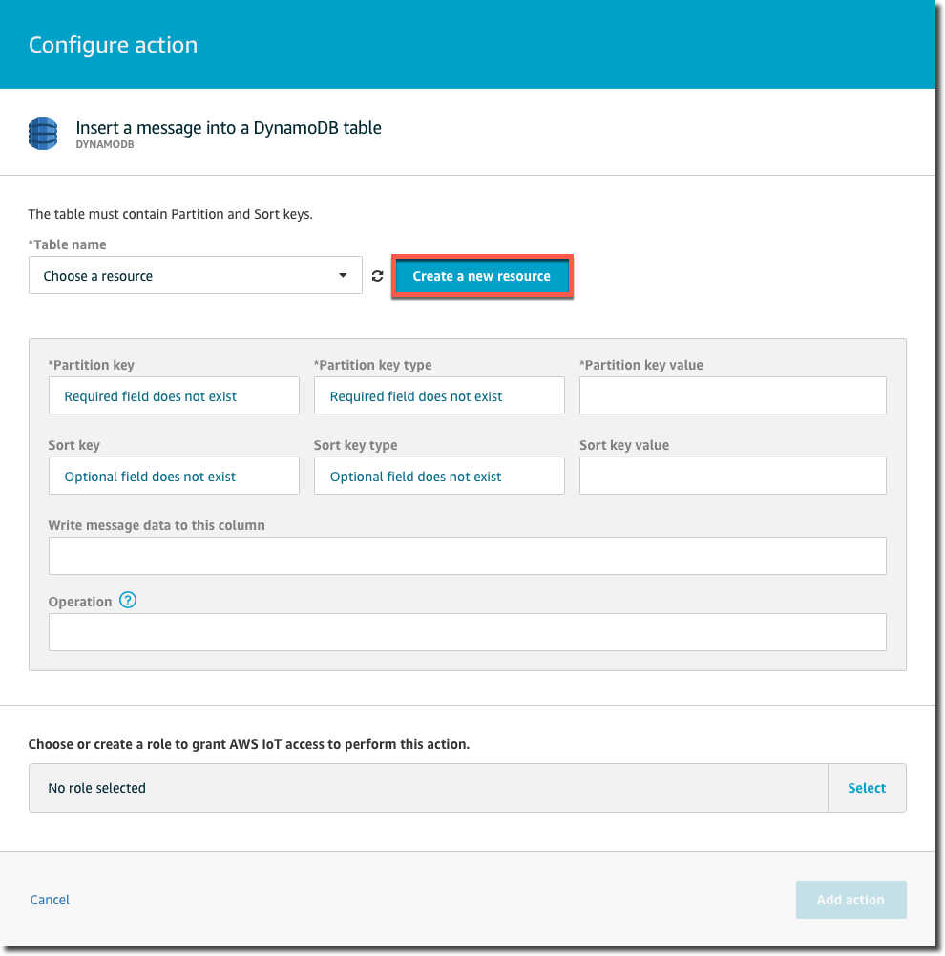

Slide 64
dynamoDB
On the Amazon DynamoDB page, choose Create table.

Slide 65
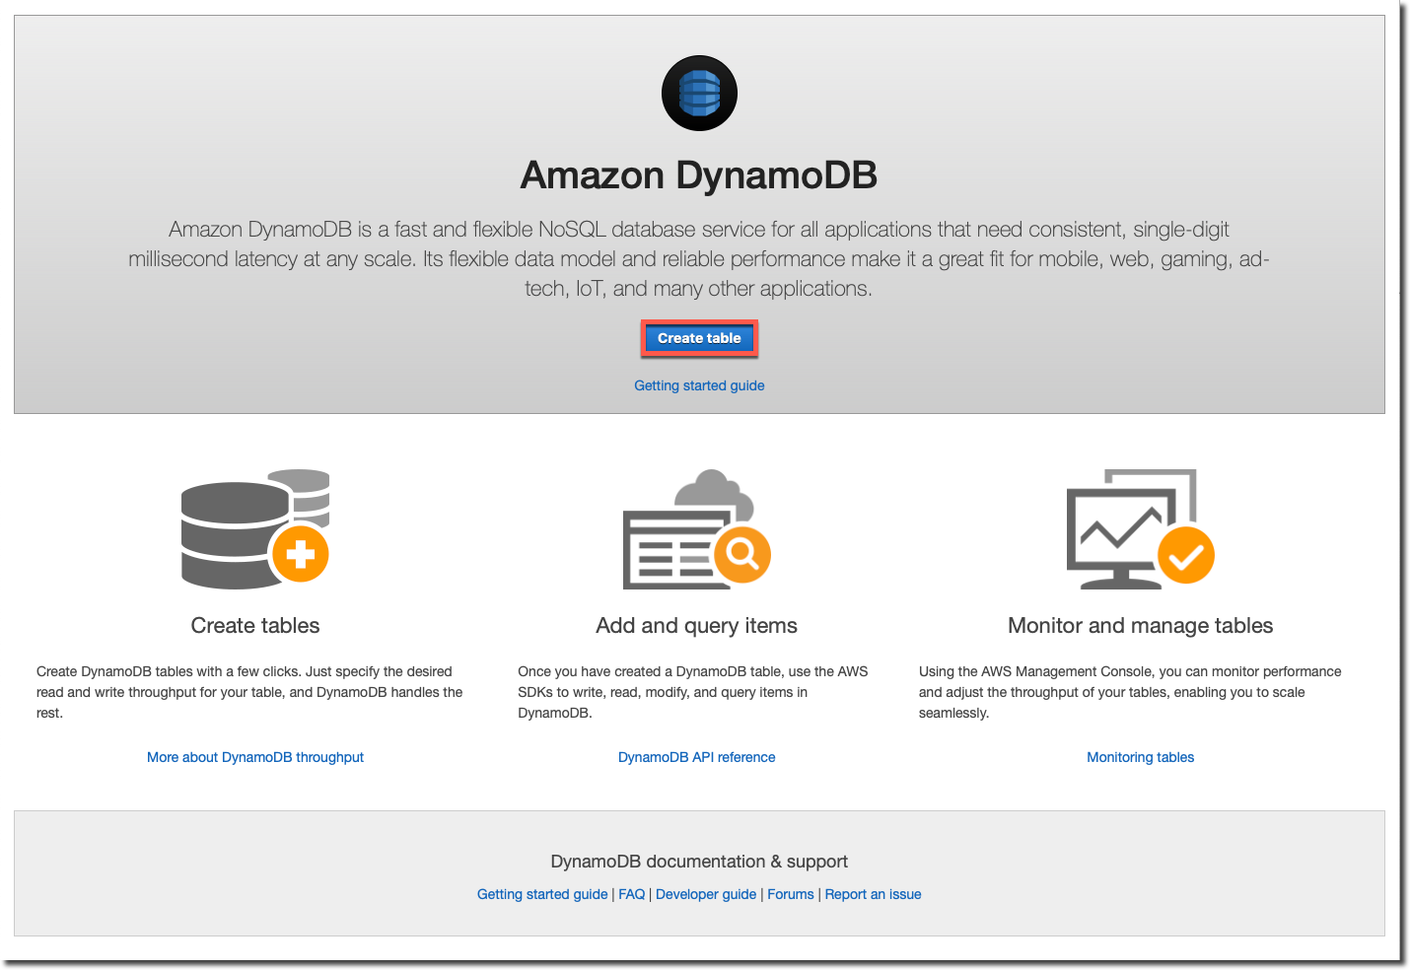

Slide 66
dynamoDB
On the Create DynamoDB table page, enter a name in Table name.
In Partition key, enter Row.
Select Add sort key, and then enter PositionInRow in the Sort key field.
Row represents a row of plants in a greenhouse.
PositionInRow represents the position of a plant in the row.
Choose String for both the partition and sort keys,
Choose Create.
It takes a few seconds to create your DynamoDB table.
Close the browser tab where the Amazon DynamoDB console is open.
If you don't close the tab, your DynamoDB table is not displayed in the Table name list on the Configure action page of the AWS IoT console

Slide 67
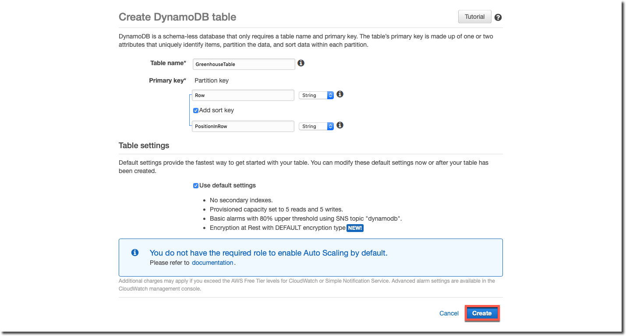

Slide 68
dynamoDB
On the Configure action page, choose your new table from the Table name list.
In Partition key value, enter ${row}. This instructs the rule to take the value of the row attribute from the MQTT message and write it into the Row column in the DynamoDB table. In Sort key value, enter ${pos}. This writes the value of the pos attribute into the PositionInRow column. Leave Write message data to this column blank. By default, the entire message is written to a column in the table named Payload. Choose Create a new role.

Slide 69
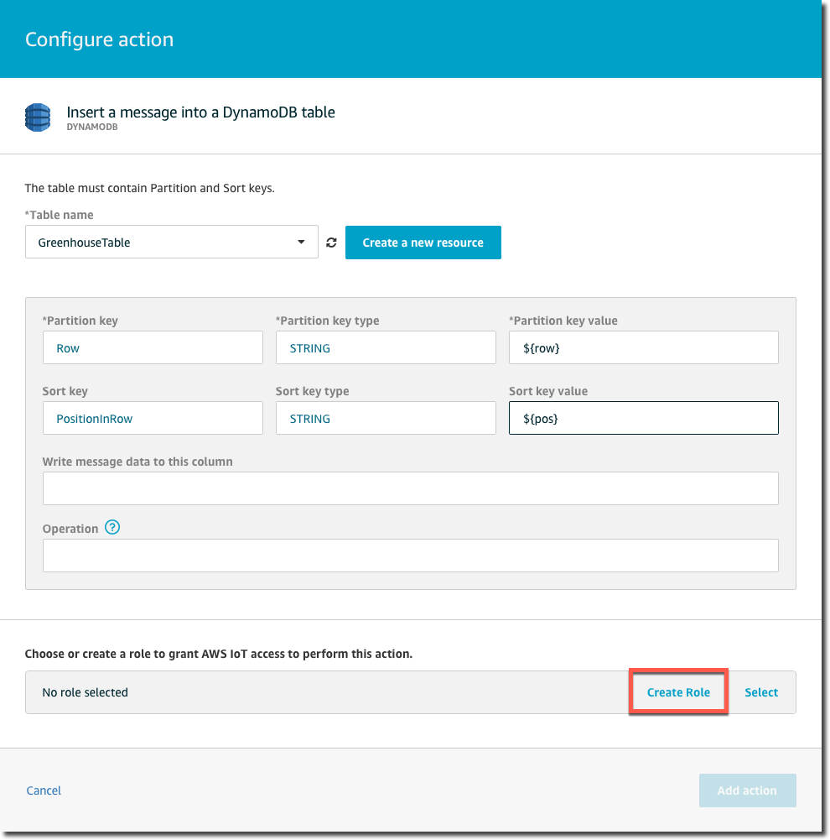

Slide 70
dynamoDB
In Create a new role, enter a unique name in Name, and then choose Create role.

Slide 71
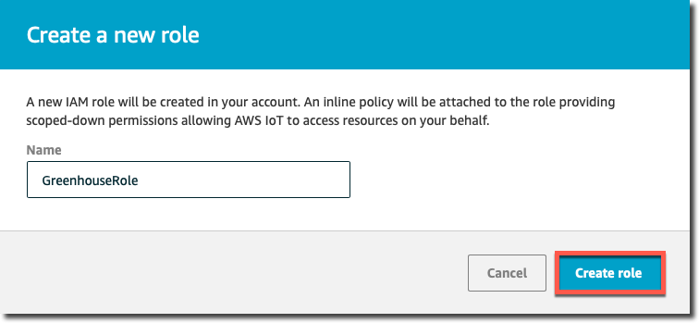

Slide 72
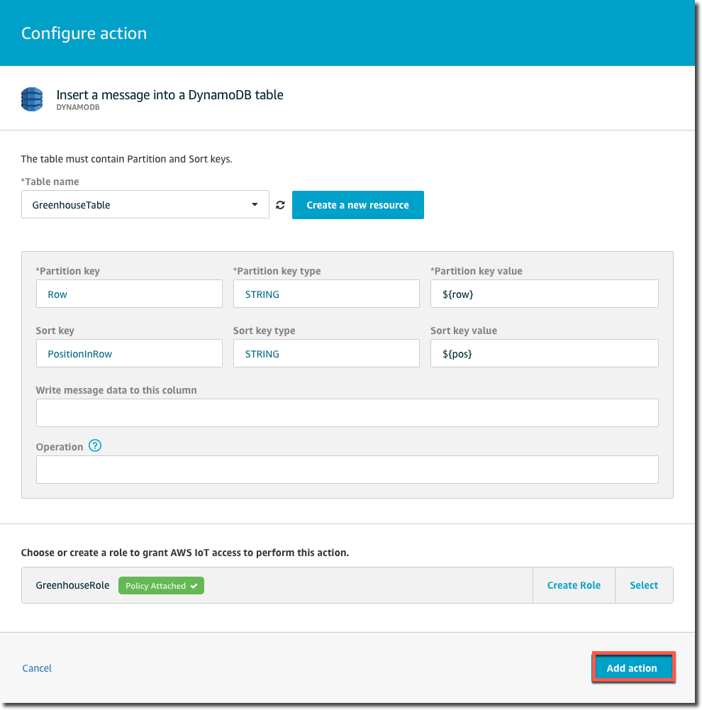

Slide 73
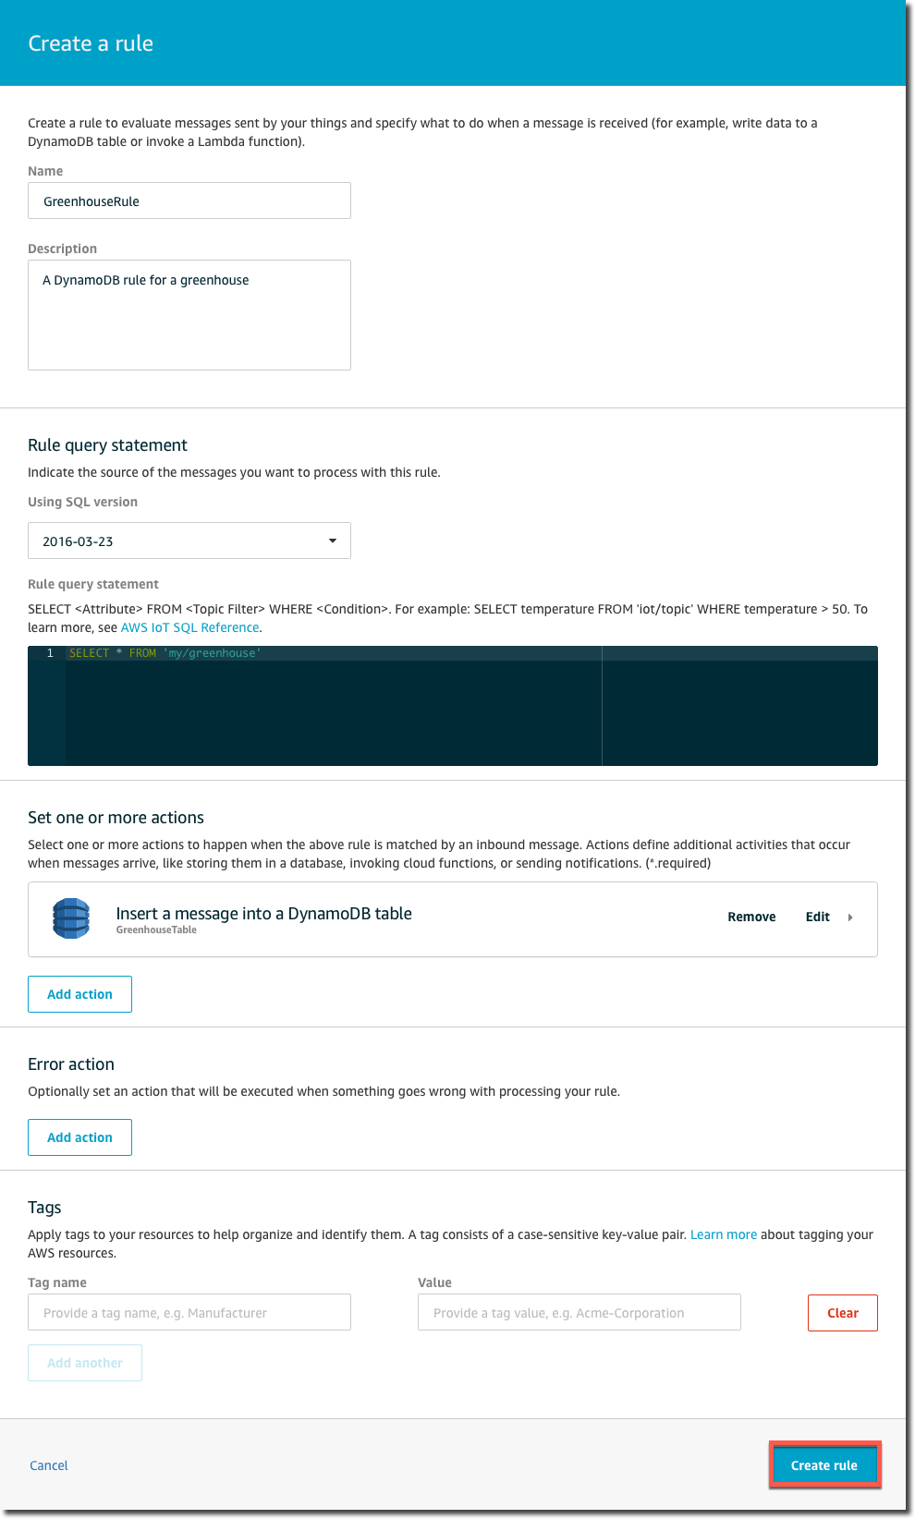

Slide 74
To test the rule, open the AWS IoT console and from the navigation pane, choose Test.
Choose Publish to a topic. In the Publish section, enter my/greenhouse as the topic. In the message area, enter the following JSON:
{
"row" : "0",
"pos" : "0",
"moisture" : "75"
}

Slide 75
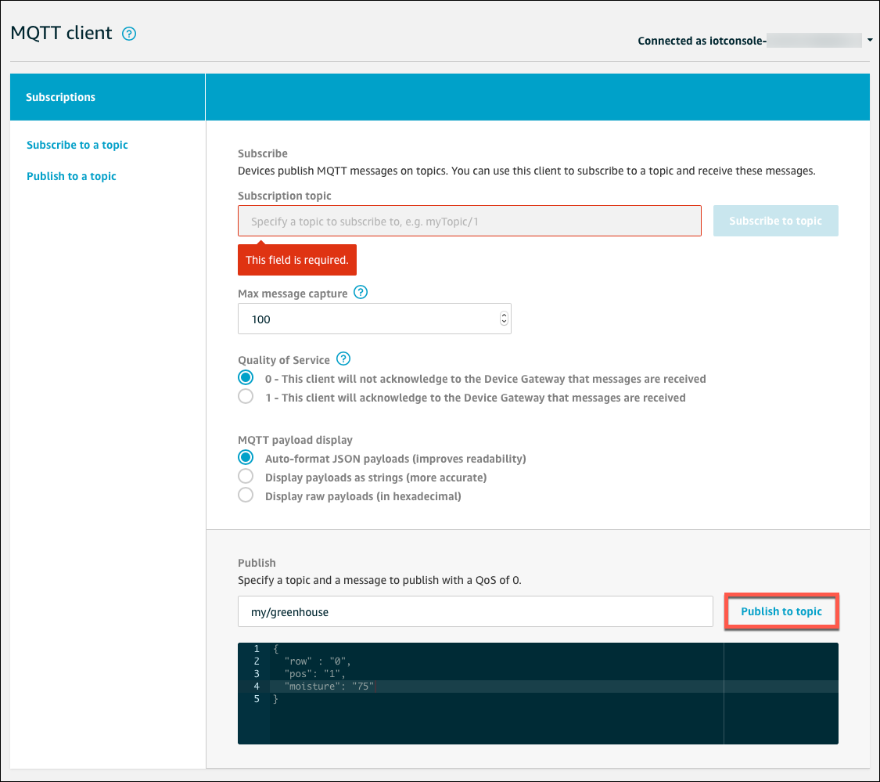

Slide 76


Slide 77


Slide 78
MQTT Code
pip install paho-mqtt
pip3 install paho-mqtt

Slide 79

MQTT Basic Code

Slide 80


Slide 81
AWS Lambda
Serverless Compute Platform for Stateless code execution in response to events

Slide 82
Create a topic in SNS
Goto SNS section
Create a new topic
Open the Amazon SNS console.
On the left pane, choose Topics.

Slide 83


Slide 84

Note the Topic ARN

Slide 85


Slide 86

Subscribe to Topic
In the Amazon SNS console, select the check box next to the topic you just created. From the Actions menu, choose Subscribe to topic.

Slide 87
Choose email

Slide 88

In the AWS Lambda console, choose Create function

Slide 89
Create Lambda Function
In the Create function page, choose Use a blueprint.
In the Blueprints filter field, enter hello-world, and then press Enter
Choose the hello-world-python blueprint, and then choose Configure

Slide 90


Slide 91
Find the template
Search for
Hello-world-python

Slide 92

In Basic information, enter a name for your function.

Slide 93
AWS Lambda
From Execution Role, choose Create a new role from AWS policy templates.
Under Role name, enter a name for the role.
From Policy templates, choose Amazon SNS publish policy. Click outside of the drop-down menu to dismiss it.

Slide 94


Slide 95

Choose Create function.

Slide 96
In the Lambda console, choose the name of your Lambda function. Information about your Lambda function is displayed.
Click on Create Function
After creating the function
Scroll down to the Function code section and replace the existing code with the following

Slide 97
Save new Code
from __future__ import print_function
import json
import boto3
print('Loading function’)
def lambda_handler(event, context): # Parse the JSON message
eventText = json.dumps(event) # Print the parsed JSON message to the console; you can view this text in the Monitoring tab in the Lambda console or in the CloudWatch Logs console
print('Received event: ', eventText) # Create an SNS client
sns = boto3.client('sns') # Publish a message to the specified topic
response = sns.publish ( TopicArn = 'arn:aws:iam::123456789012:role/service-role/myLambdaFunctionRole', Message = eventText )
print(response)

Slide 98
ARN Topic
In the above code, replace the ARN of amazon SNS Topic which we had saved

Slide 99
Lambda Function
Inside the CODE,
Replace the value of TopicArn with the ARN of the Amazon SNS topic you created earlier
Save

Slide 100


Slide 101
Test your Lambda Function
In the upper right of the Lambda function detail page, from Select a test event, choose Configure test events.

Slide 102


Slide 103
On Configure test event, enter a name for your test event and replace the message JSON with the following
Choose Create.
{
"message" : "Hello, world"
}

Slide 104


Slide 105
Test
In the upper right of the Lambda function detail page, choose Test to test your Lambda function with the message you specified in the test event.

Slide 106


Slide 107
Test
Under your Lambda function code, on the Execution result tab, you see the output from the Lambda function

Slide 108


Slide 109
Create a Lambda Rule
Browse to the AWS IoT console, and from the navigation pane, choose Act.
Choose Create to create an AWS IoT rule
On the Create a rule page, enter a name for your rule.
In Rule query statement, enter the following query
In Set one or more actions, choose Add action.
Under Select an action, choose Send a message to a Lambda function, and then choose Configure action
On Configure action, choose Select
Choose your Lambda function.
Choose Add action.
On the Create a rule page, in Error action, choose Add action
SELECT * FROM "my/lambda/topic"

Slide 110


Slide 111


Slide 112


Slide 113

SELECT * FROM "my/lambda/topic"

Slide 114


Slide 115


Slide 116


Slide 117


Slide 118


Slide 119

On the Create a rule page, in Error action, choose Add action

Slide 120
On the Set an action as error action page, choose Republish a message to an AWS IoT topic, and then choose Configure action.

Slide 121


Slide 122

On the Configure action page, under Topic, enter lambda/error.

Slide 123

Under Choose or create a role to grant AWS IoT access to perform this action, choose Create Role.

Slide 124

In Create a new role, enter a name for the role, and then choose Create role.

Slide 125

In Configure action, choose Add action.

Slide 126

In Create a rule, choose Create rule

Slide 127

Test Your Lambda Rule

Slide 128

In the MQTT client, under Subscription topic, enter lambda/error, and then choose Subscribe to topic

Slide 129

Test
Under Publish, enter my/lambda/topic, and then choose Publish to topic to publish the default JSON message

Slide 130
Publishing this message should trigger the rule and call your Lambda function. Your Lambda function pushes an Amazon SNS message to a phone number subscribed to your Amazon SNS topic. If you do not get a text message, in the MQTT client, check to see if any messages were published to lambda/error.

Slide 131


Slide 132
AWS IoT Security

